Slide 1


An Earth-Moon/Mars Cargo Transport System
DOUG PLATA MD, MPH
Space Development Network
DougSpace007@gmail.com
909-557-7483

Slide 2
Overview
Notes:
2

Slide 3
Overview
Introductions
Context
Types of payload bays
Shipping containers
From KSC to Luna
Discussion
What now?
l
l
l
l
l
l
l
Notes:
3

Slide 4
Introduction
Notes:
4

Slide 5
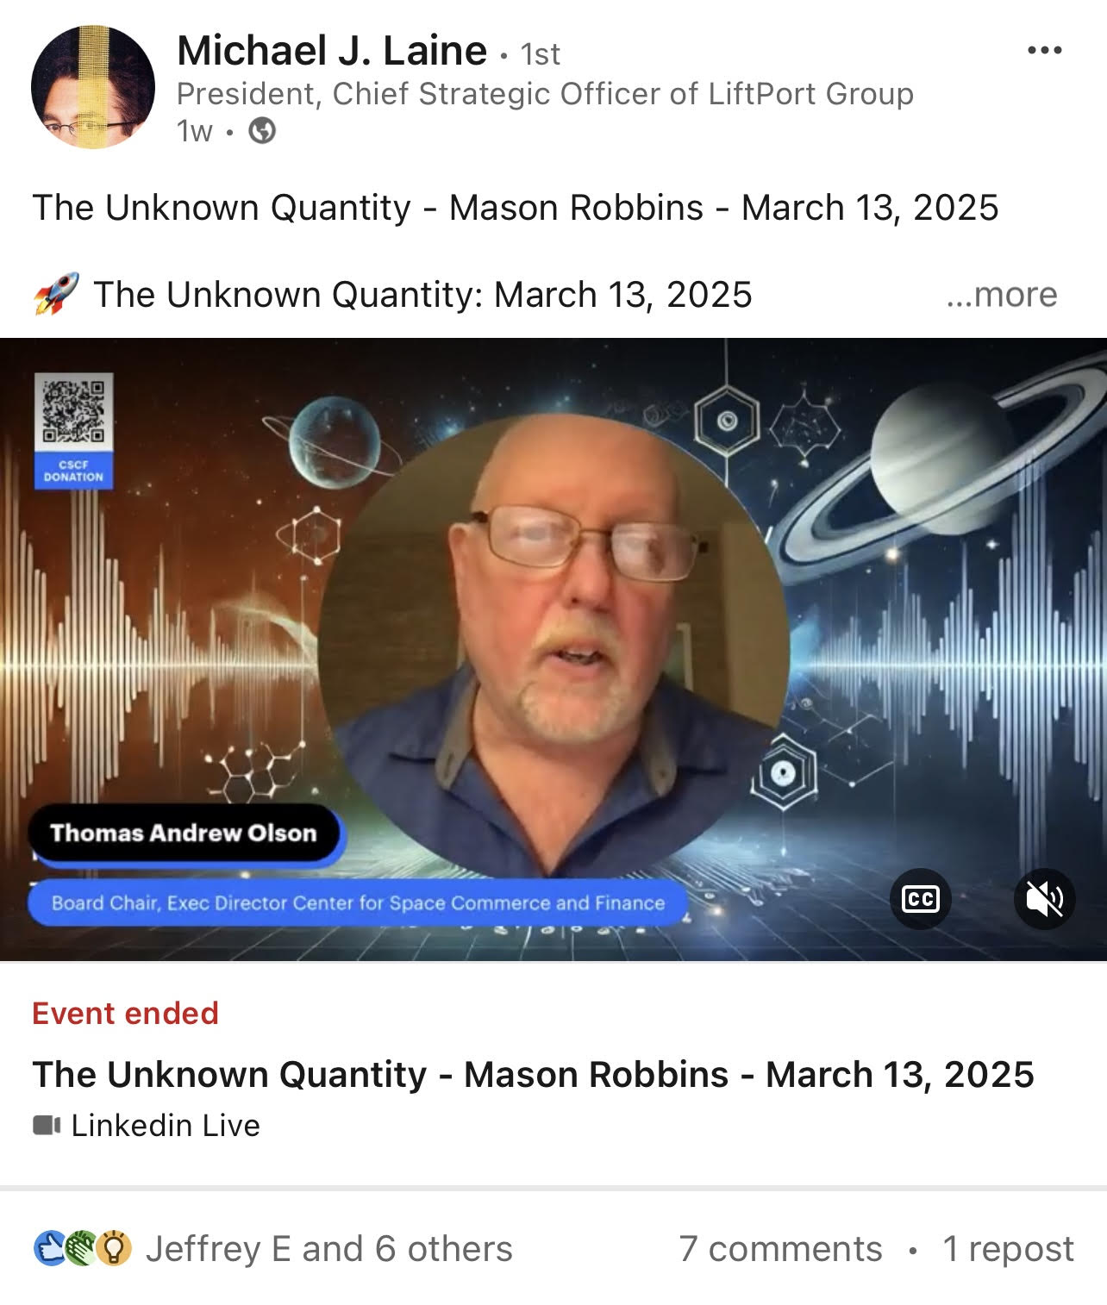
Introduction
Notes:
5

Slide 6
Context
Notes:
6

Slide 7
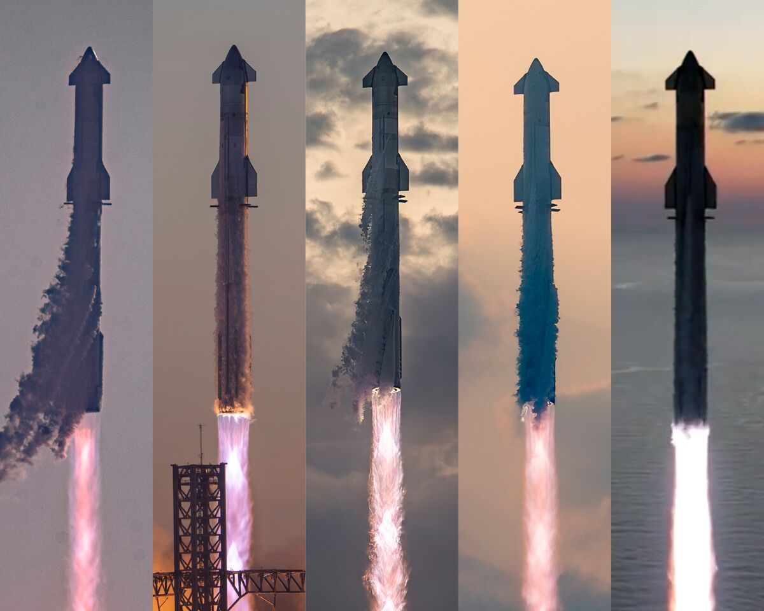
The Starship Fleet
Notes:
7

Slide 8
Types of
Payload Modules
Notes:
8

Slide 9
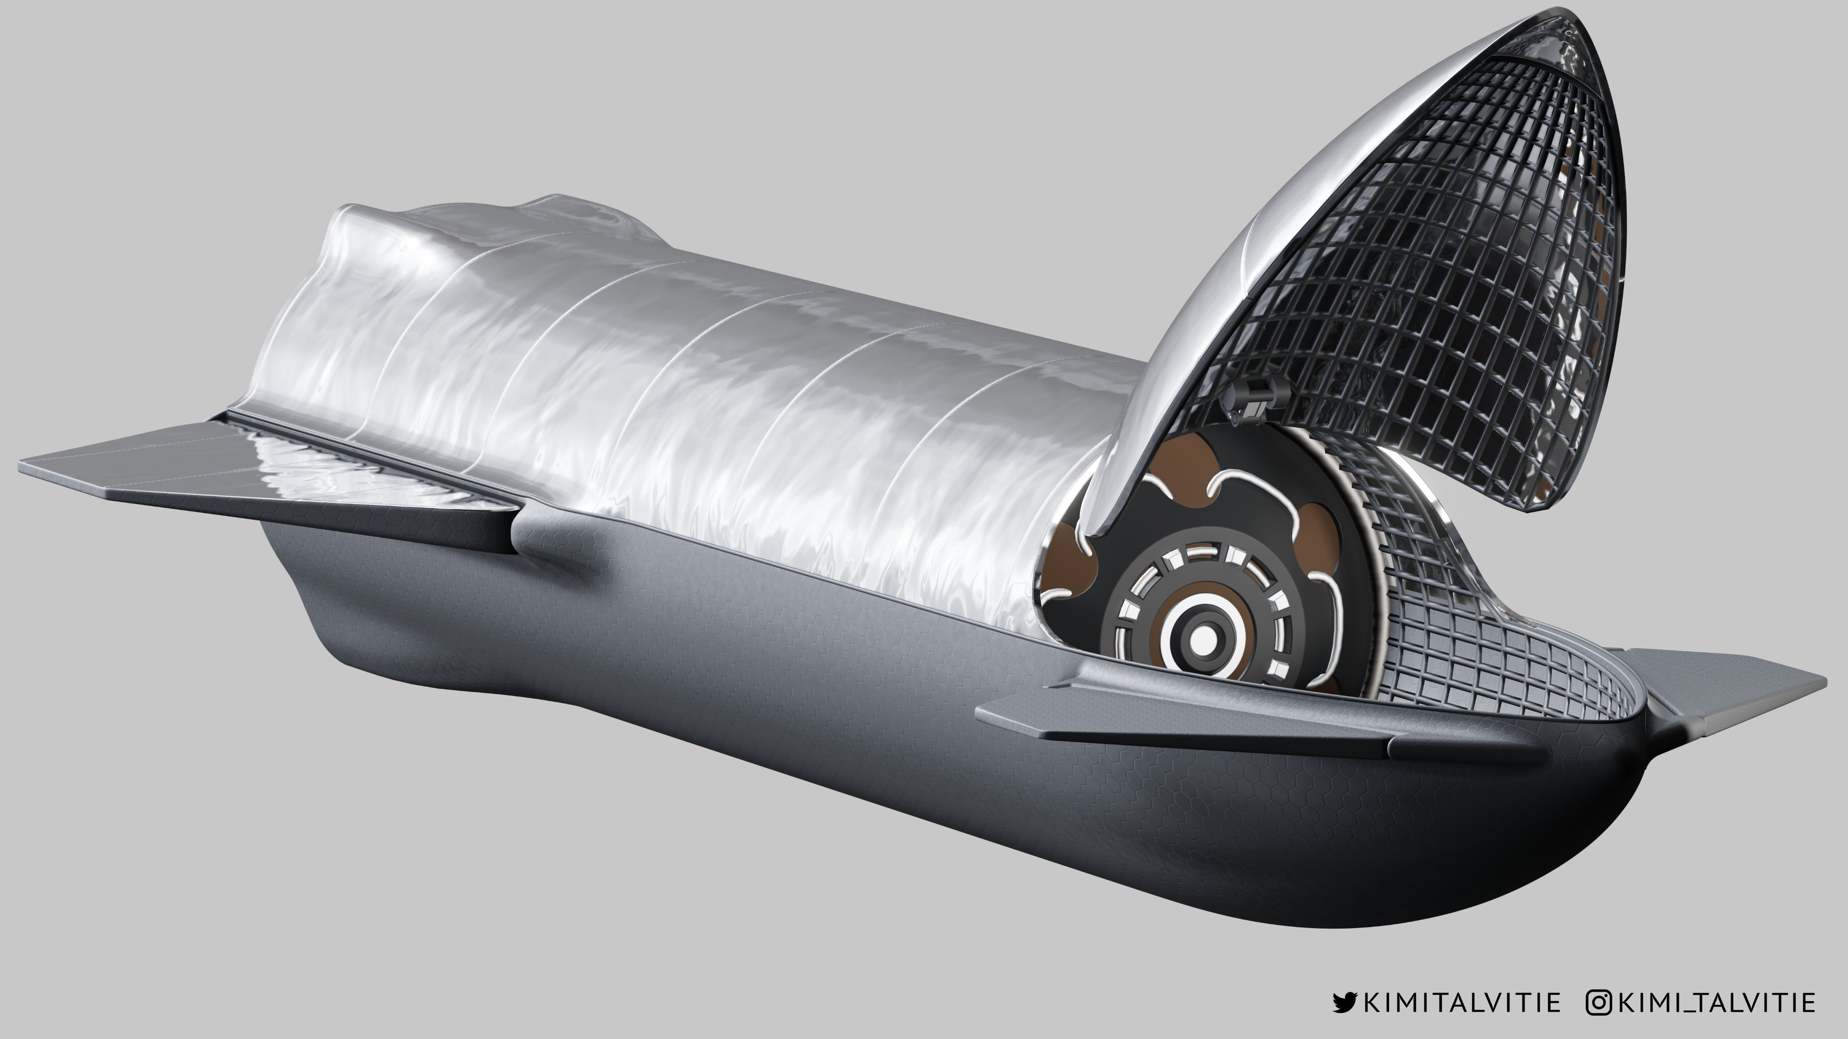
Unitary vs Multiple
Notes:
9

Slide 10
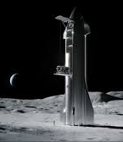
Unitary vs Multiple
Notes:
10

Slide 11
Shipping Containers
Notes:
11

Slide 12
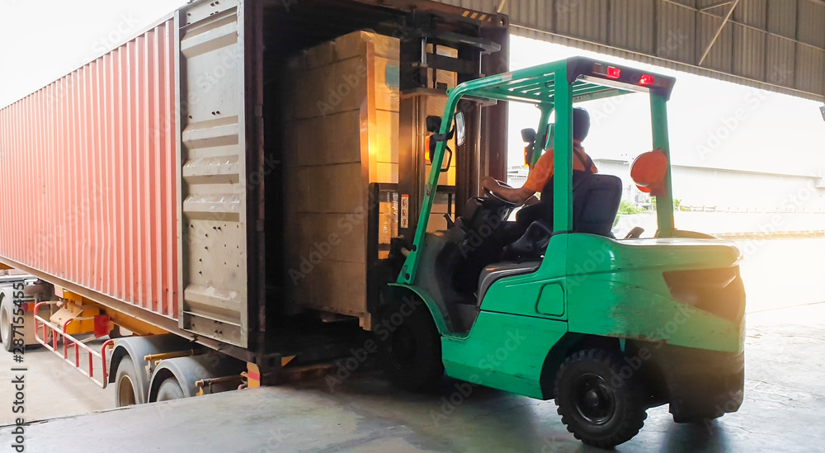
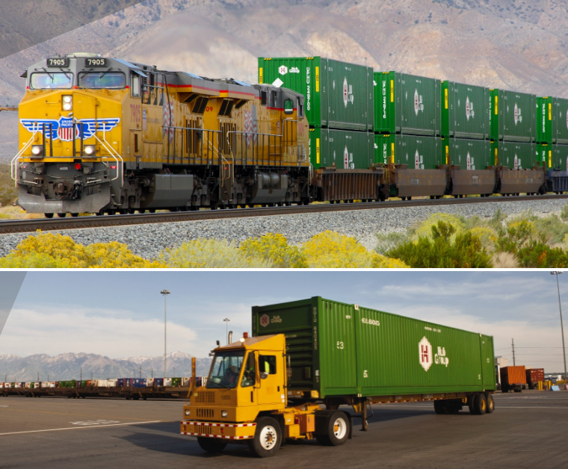
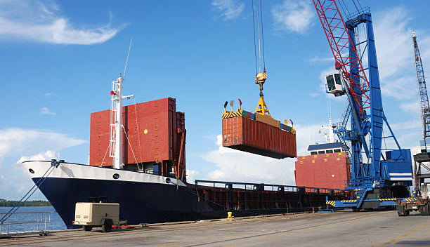
Standard Shipping Sizes
Notes:
12

Slide 13
Categories of Payloads
Unitary
Liquid
Bulk
Containers
l
l
l
l
Notes:
13

Slide 14
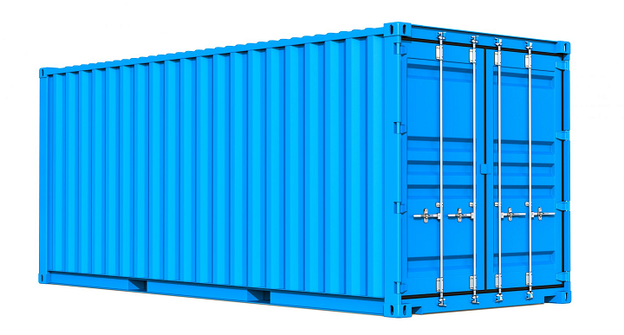
Pressurized vs Unpressurized
Notes:
14

Slide 15
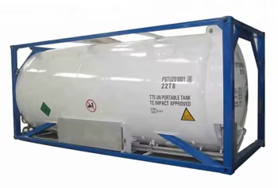
Pressurized vs Unpressurized
Notes:
15

Slide 16
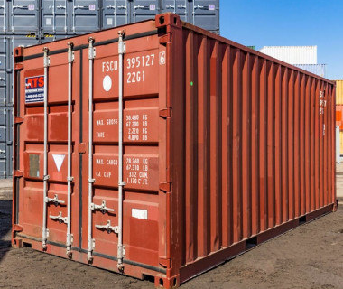
Container Composition
Copper
Other metals
Plastic
Graphite/ene
l
l
l
l
Notes:
16

Slide 17
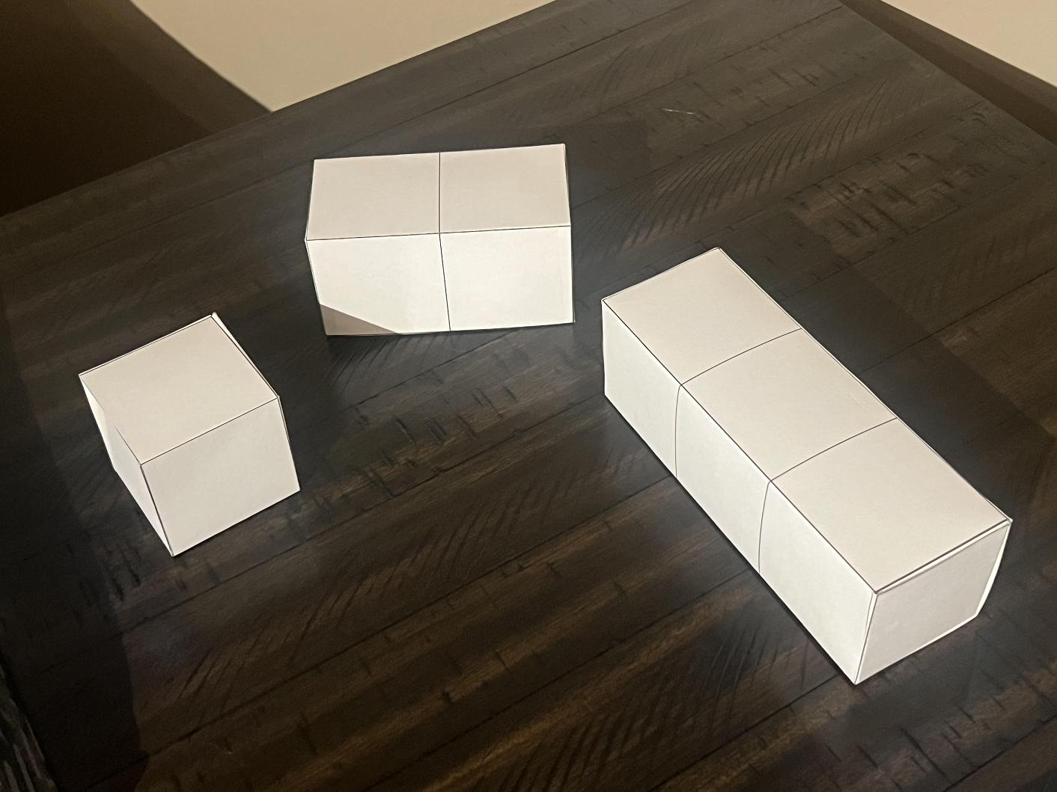
Shipping Container Sizes
Notes:
17

Slide 18
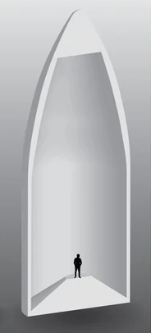
Containers in Fairings
Notes:
18

Slide 19
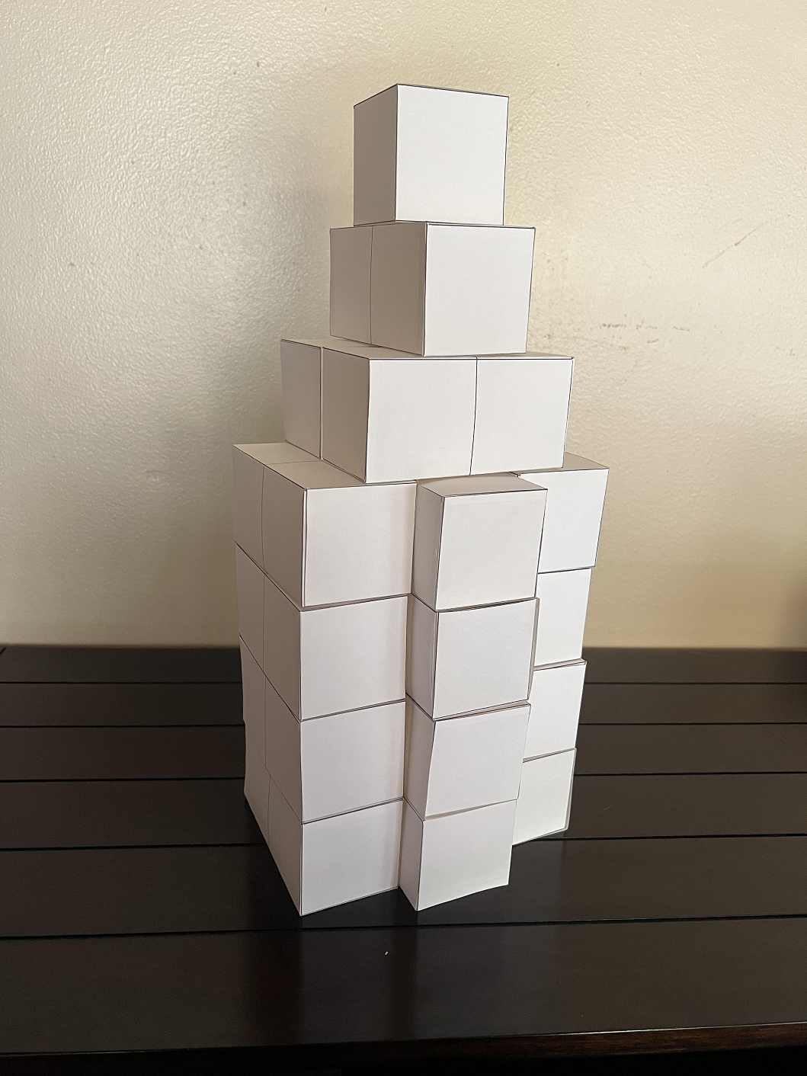
Containers in Fairings
Notes:
19

Slide 20
Smart Containers
Notes:
20

Slide 21
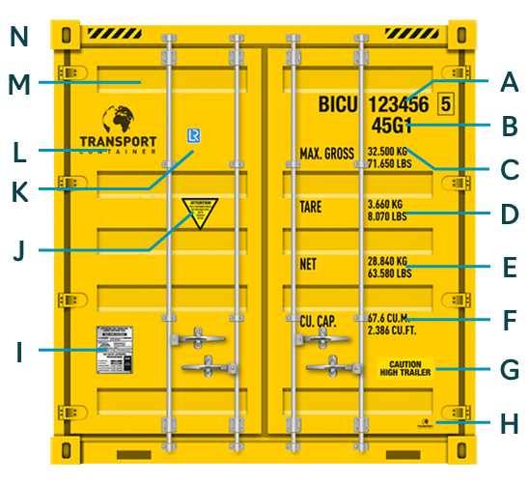
ID & Labeling
Notes:
21

Slide 22

Monitoring
“Every container should measure and record dynamic forces experienced for the entire journey. 9 DOF gyro and acceleration, temp, pressure, humidity, etc”.
Notes:
22

Slide 23
From KSC to Luna
Notes:
23

Slide 24
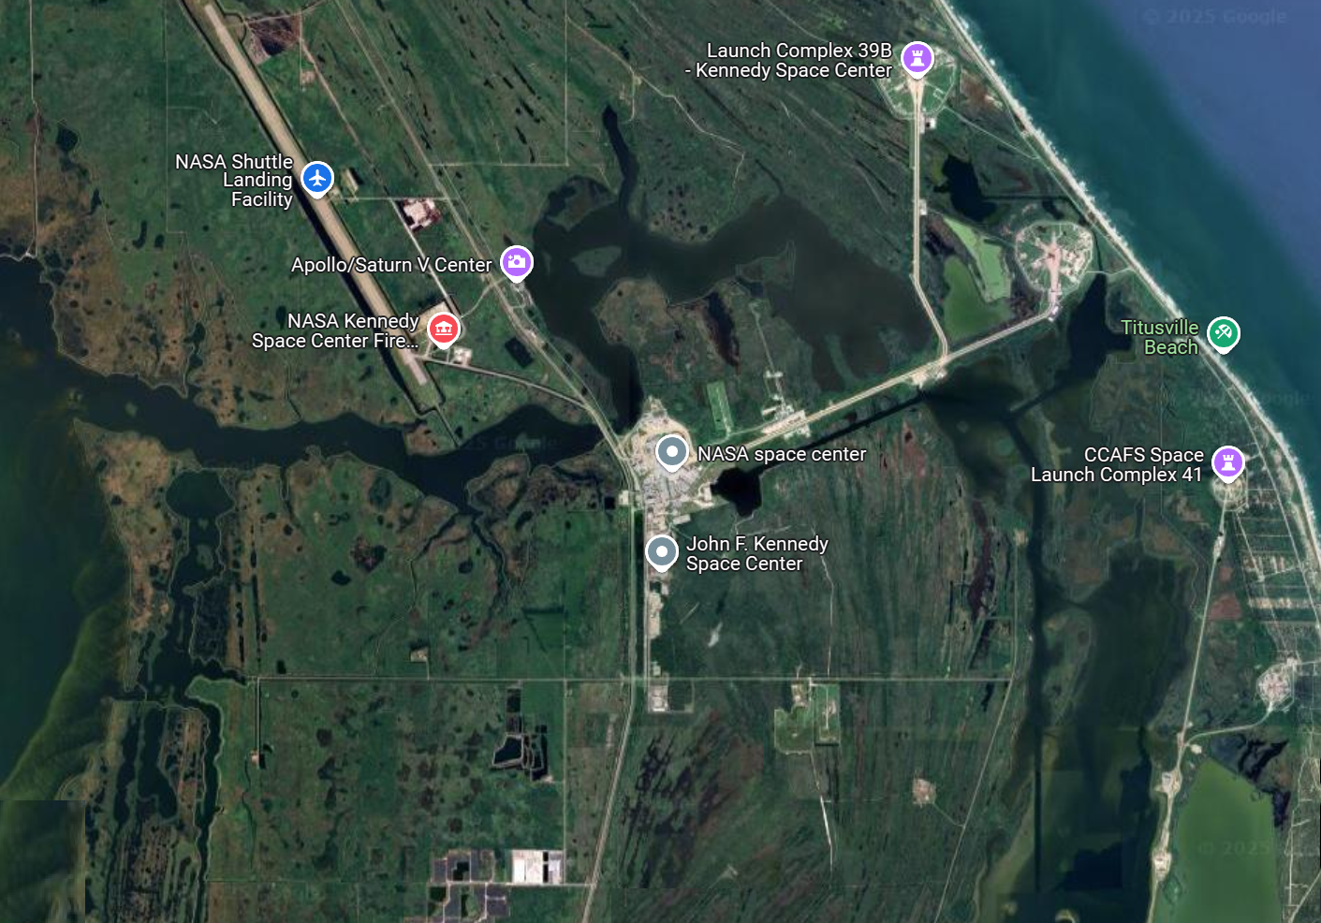
KSC Receiving Facility
Notes:
24

Slide 25
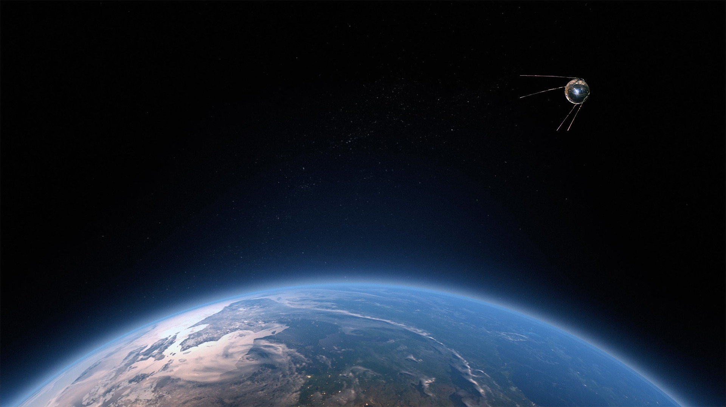
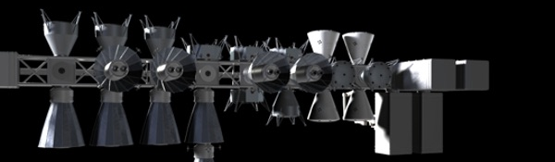
LEO Logistics Facility?
Notes:
25

Slide 26
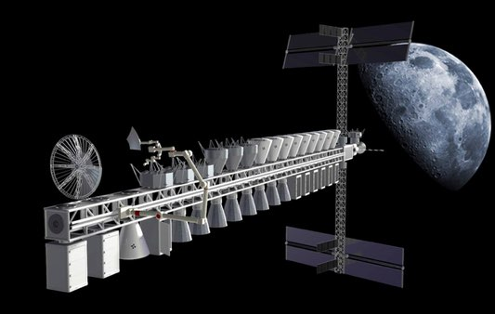

EML1 Logistics Facility?
Notes:
26

Slide 27
EML1 Logistics Facility?
Notes:
27

Slide 28
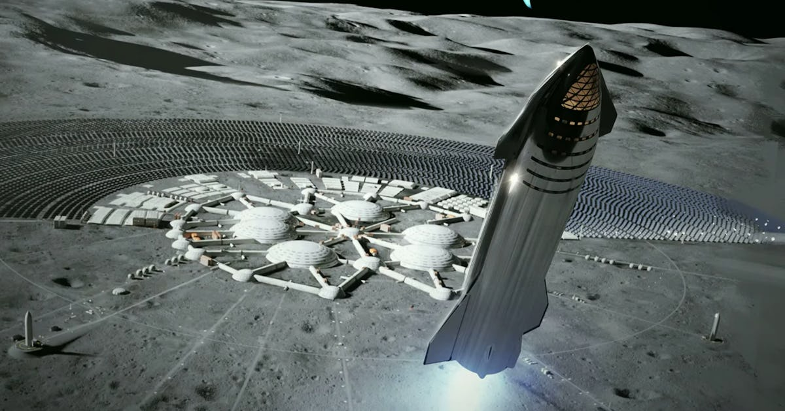
Luna Receiving Facility
Notes:
28

Slide 29
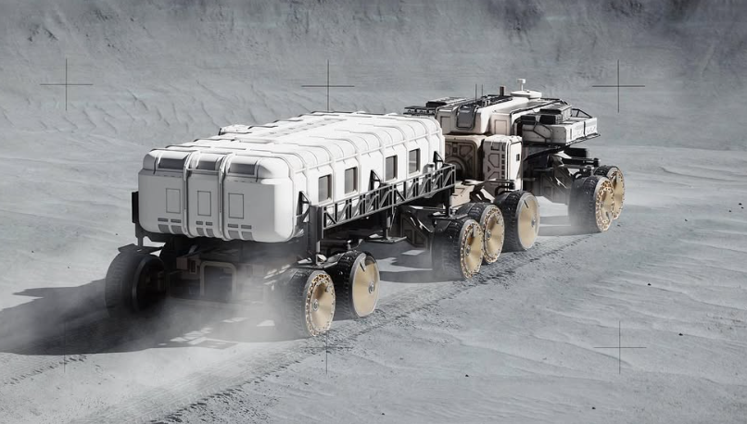
Surface Transport
Notes:
29

Slide 30
Discussion
Notes:
30

Slide 31
What Now?
Notes:
31

Slide 32

Thank you for
your attention
DOUG PLATA MD, MPH
Space Development Network
DougSpace007@gmail.com
909-557-7483

