Slide 1
Papercraft Pages
for the
InstaBase

Slide 2
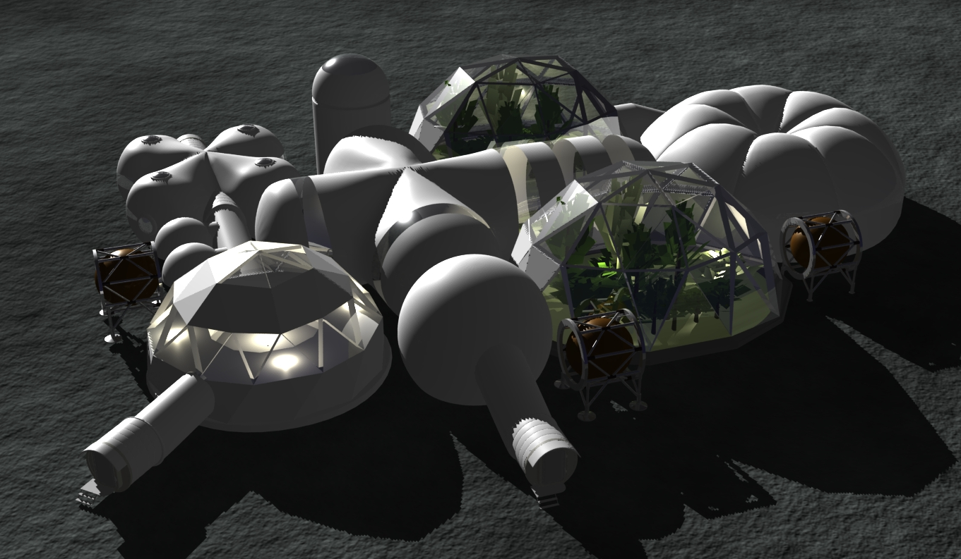
Rendering
The InstaBase would be set up rapidly through simple inflation with condensed air. It is intended to provide for all of the needs of an Initial Crew of eight.

Slide 3


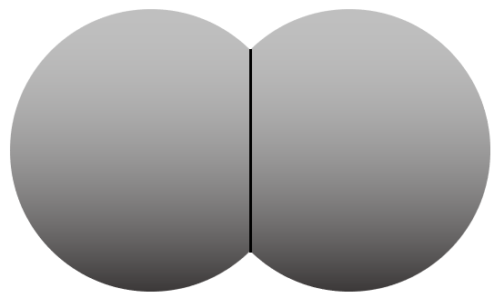
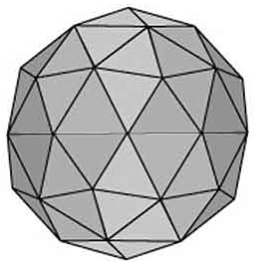
BackPort
GreenHab
Tower
O2
H2O
BedHab
SidePort
BathHab
WorkHab
SpinHab
Instabase Modules
H2O
LivingHab
H2O
ArtHab
MetalsArea
GreenHab
Organics
BubbleHab
FrontPort

Slide 4
Dimensions
6.0 m
2.0 m
2.5 m
1.25 m
1.0 m
5.0 m
12 m
6.0 m
0.5 m
2.5 m
1.5 m
0.75 m
7.5 m
Actual diameter (m) | PPT (in) | Module
5 | 2.5 | BedHab
3.5 | 1.75 | BathHab
2 |  | Hallway
6.5 | 3.25 | LivingHab
6.5 | 3.25 | ArtsHab
4.5 | 2.25 | WorkHab
12 | 6 | GreenHabs
15 | 7.5 | SpinHab
1.75 m
2.0 m
2.25 m
1.13 m
4.5 m
2.25 m
3.5 m
6.5 m
15 m
3.25 m
2.0 m
6.5 m
2.0 m
2.0 m
2.0 m
3.25 m
5.0 m
6.5 m
2.0 m
3.5 m?
4.0 m
2.5 m

Slide 5
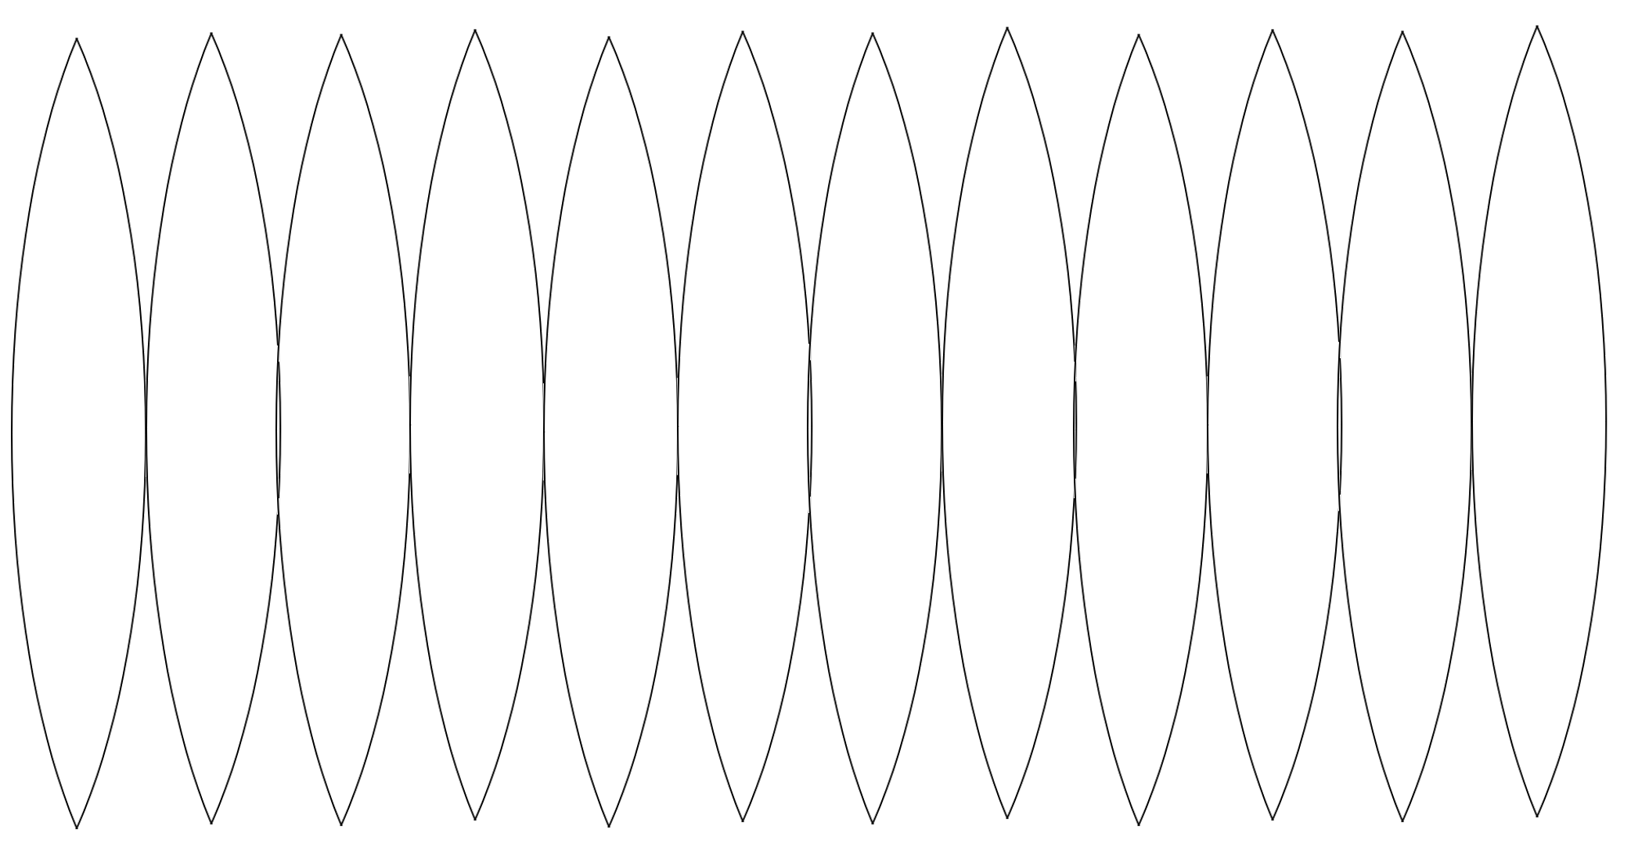
BedHab – Floor & Roofs
Tower

Slide 6
BedHab1 & 2

Slide 7
BedHab3 & 4

Slide 8

BathHab1 & 2
BubbleHab

Slide 10
ArtsHab

Slide 11
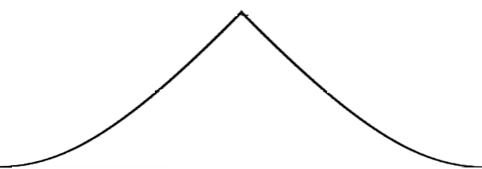
WorkHab

Slide 12
WorkHab

Slide 13
GreenHab1

Slide 14
GreenHab1

Slide 15

GreenHab1

Slide 16
GreenHab2

Slide 17
GreenHab2

Slide 18
GreenHab2

Slide 19
SpinHab

Slide 20
SpinHab

Slide 21
SpinHab

