Slide 1
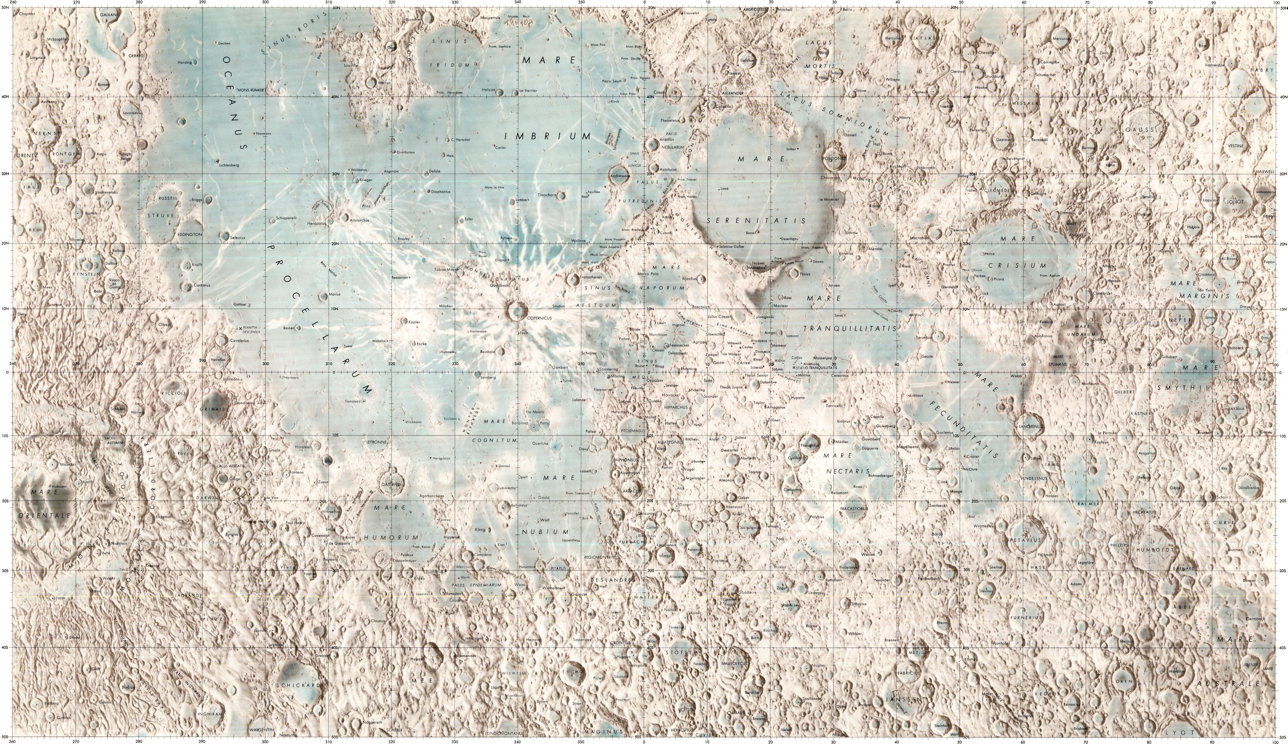
GRAND TOUR
L1
A15
Aristarchus & Herodotus
A17
Ina
Copernicus
Reiner Gamma
A11
A12
Chang-e 1
S3
A14
LaLande
A16
Tycho

Slide 2
SECONDARY ROADS
L1
A15
Aristarchus & Herodotus
A17
Ina
Copernicus
Reiner Gamma
A11
Chang-e 1
A12
S3
A14
LaLande
A16
Tycho

Slide 3
