Slide 1
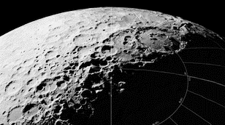
Earth Independence:
Introduction & Rationales
DOUG PLATA MD, MPH
President & Founder,
The Space Development Network
SpaceDevelopment.org
DevelopSpace1@gmail.com

Slide 2
Track Overview
Goal: Present the current state of thinking about how a permanent lunar base could become largely (or even entirely) Earth independent.
This track starts the conversation.

Slide 3
NSS – Roadmap
MILESTONE 31: Survival of the Human Species via Space Settlement
Through the general expansion of space settlement and the development of specific, isolated settlements designed to survive, space settlement increases the likelihood that the human species will survive in the long term.

Slide 4
Presentation Overview
What is “Earth independence”?
The two types of Earth independence?
Reasons for Earth independence
What are the elements of Earth independence?
Can Earth independence be measured?
How far can we take this?
The concept of “sufficient supply”.

Slide 5
What is “Earth Independence”?

Slide 6
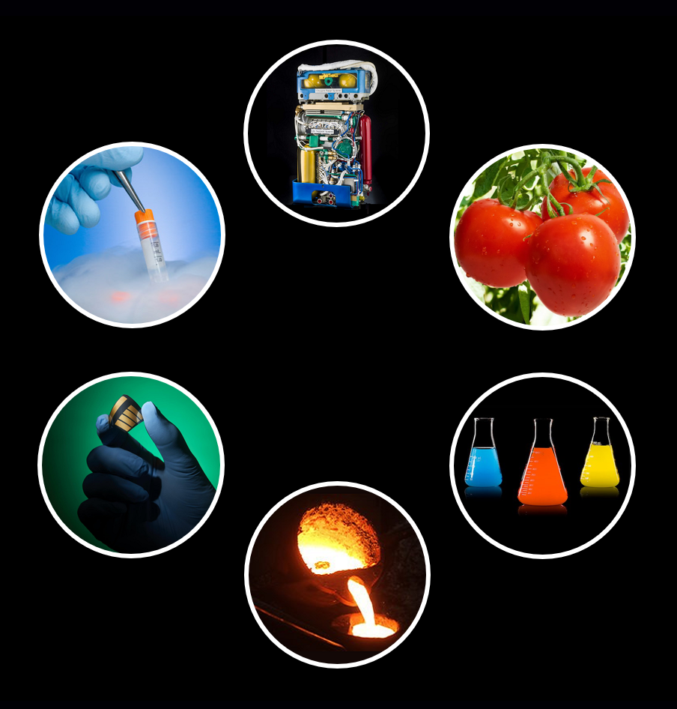
What is Earth Independence?
Earth Independence:
The use of in situ resource utilization (ISRU), recycling, and other means to decrease or eventually eliminate the need for supply deliveries from Earth.
Notes:
6

Slide 7
What is Earth Independence?
Notes:
7

Slide 8
The Two Types of Earth Independence”?

Slide 9
Two Types of Earth Independence?
Analogies
Relevant Factors
Notes:
9

Slide 10
Two Types of Earth Independence?
General independence
Survival colony
Notes:
10

Slide 11
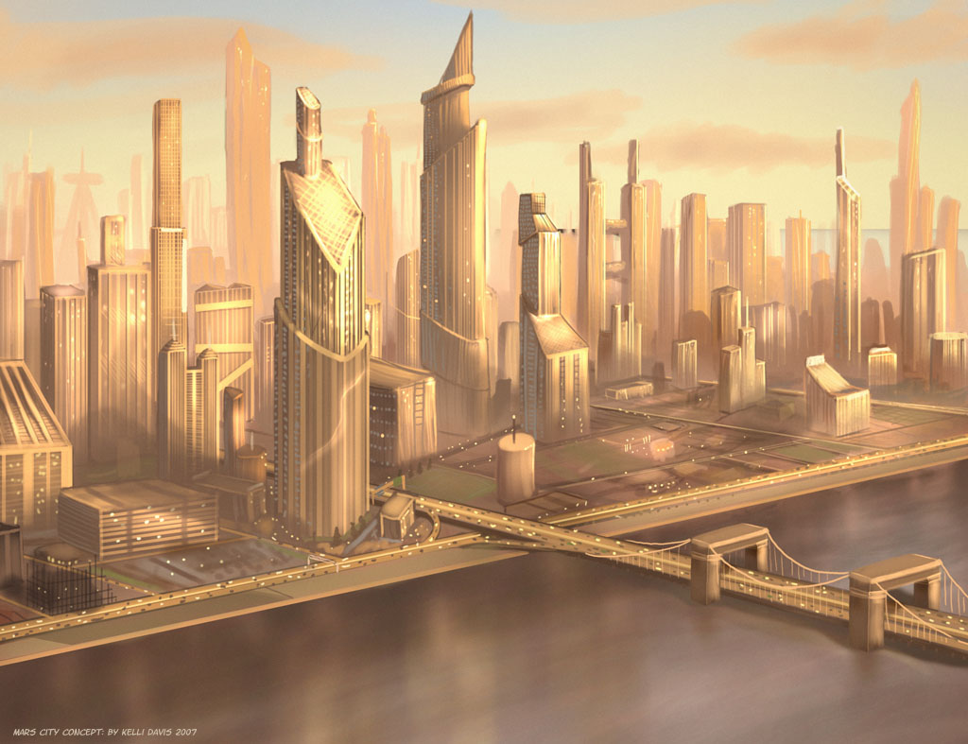
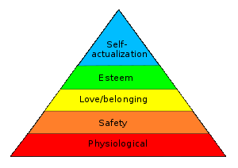
Two Types of Earth Independence?
Cities
Essential Needs
Notes:
11

Slide 12
The Elements of Earth Independence

Slide 13
The Elements of Earth Independence
IMMEDIATE (minutes --> hours)
- Air pressure
- Oxygen
- Temperature control
- Power
- Electronics
Notes:
13

Slide 14
The Elements of Earth Independence
INTERMEDIATE (days --> months)
- Drinkable water
- Food
- Equipment reproduction
- Radiation protection
- Sanitation
Notes:
14

Slide 15
The Elements of Earth Independence
LATER (years)
- Habitat reproduction
- Isolation
- Sufficient gravity
- Information (tech & protocols)
- Genetic diversity
- Translocation
Notes:
15

Slide 16
Reasons for Earth Independence

Slide 17
Reasons for Earth Independence?
Reduce costs.
Increase security of supplies.
Ensure the survival of the human species.
Ensure the survival of the biosphere.
Notes:
17

Slide 18
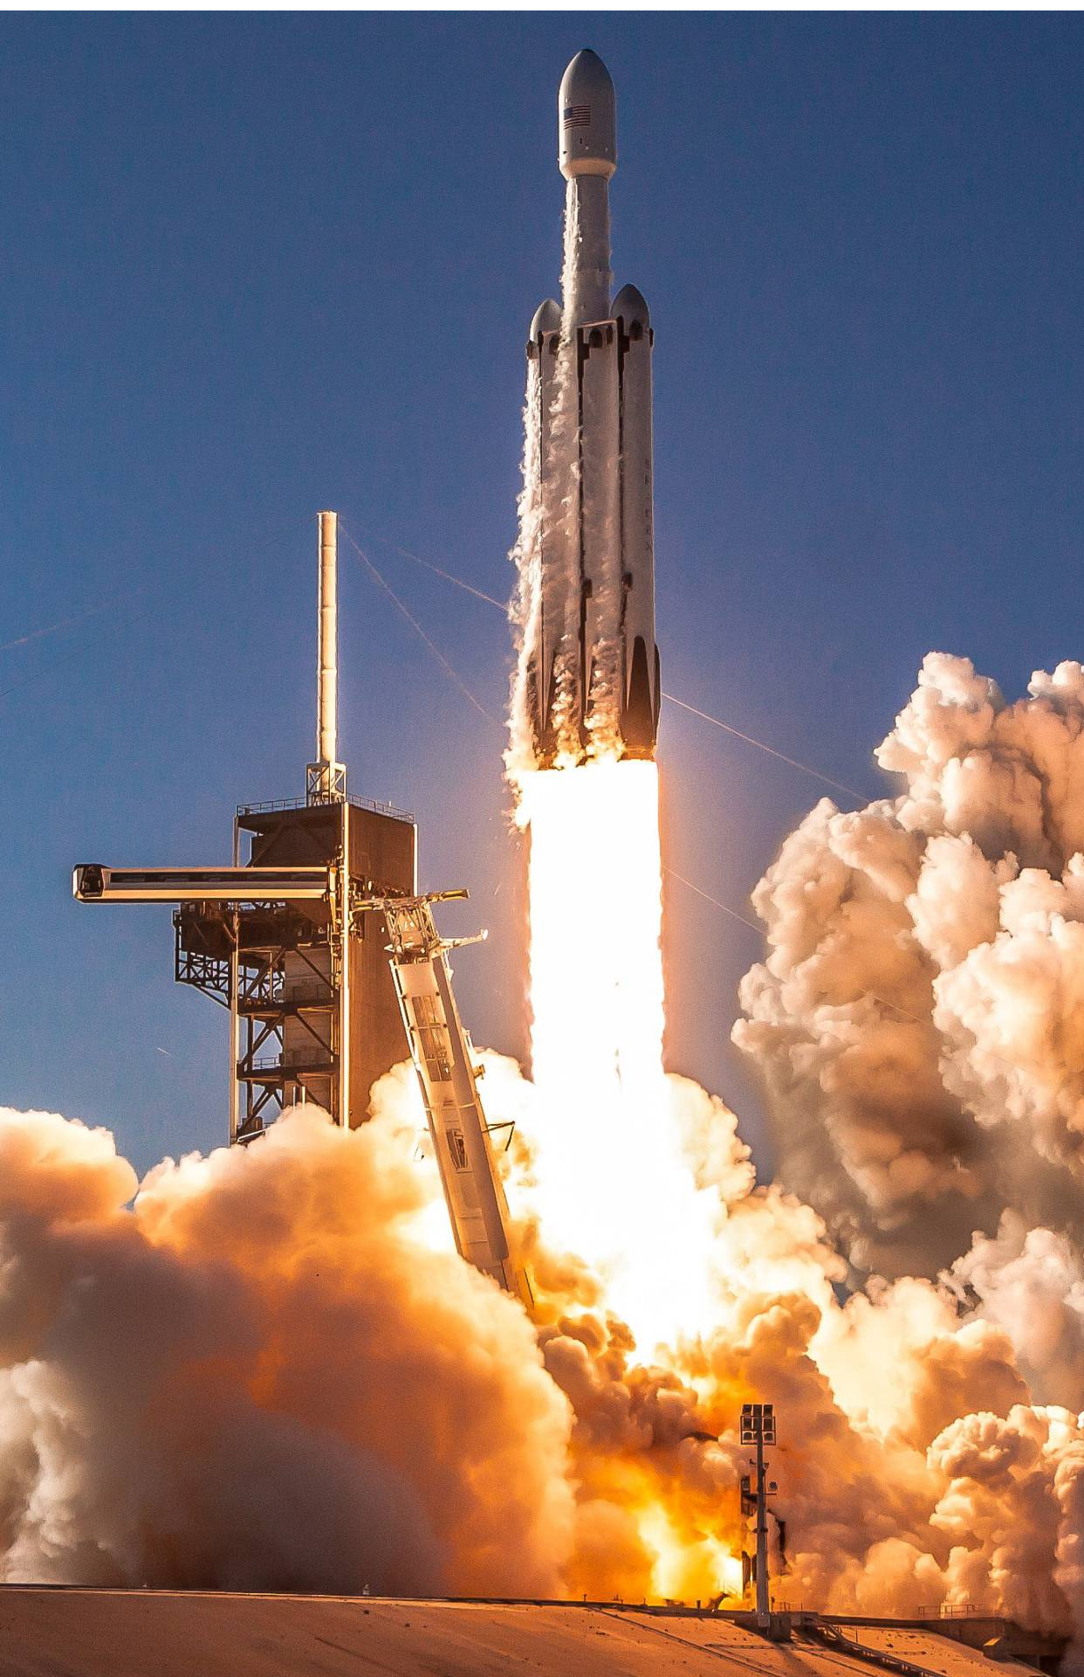
Reducing Costs
Reduce # of launches
Speed the development of the colony.

Slide 19
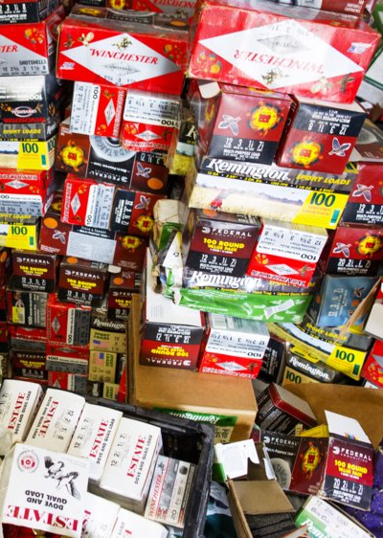
Safety of Supplies
In case supply temporarily interrupted.
Unexpected running out of an item.

Slide 20
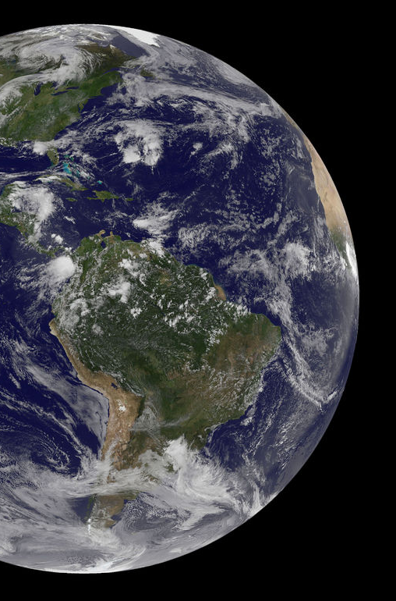
Ensuring Survival
Permanent loss of external supply.
Human species.
Biosphere.

Slide 21
Reasons for Earth Independence
Reducing Costs
Securing Supplies
Ensuring Survival
0% 25% 50% 75% 100%

Slide 22
Measuring Earth Independence

Slide 23
Measuring Earth Independence?
Percent Mass Independence:
The amount of mass that no longer has to be shipped from LEO in order to support an increasingly Earth-independent base.
Notes:
23

Slide 24
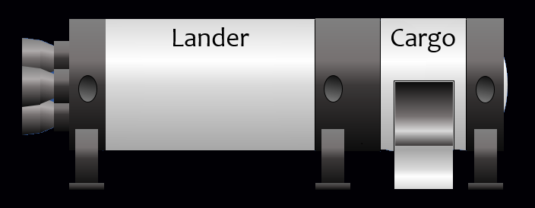
Measuring Earth Independence?
0%
ISRU.
Recycling ..
Extended stay .
Sufficient supply
75%
Notes:
24

Slide 25
Percent Mass Independence
45% - Descent propellant 23% - Ascent propellant 10% - Water 5% - Inflatable habitat material 5% - Gross metal parts 4% - Food 2% - Paper goods 2% - Crew 2% - Organic materials 2% - Clothing & furnishings 1% - Precision metal parts 1% - Electronics
Notes:
25

Slide 26
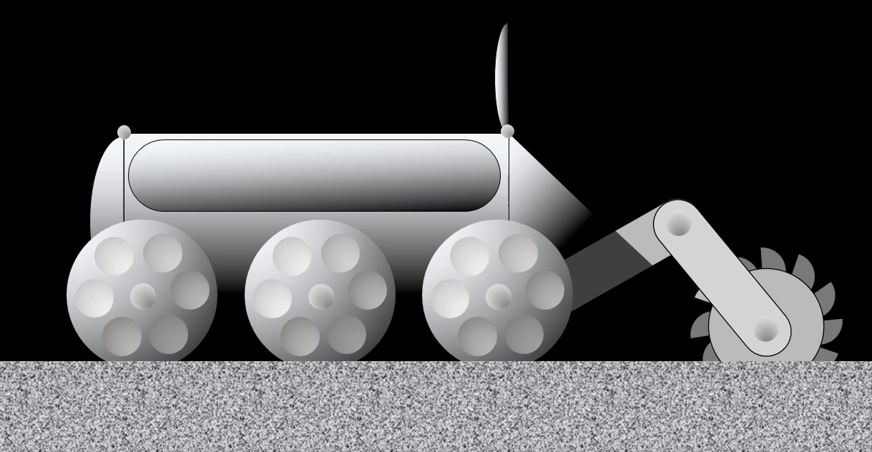
Percent Mass Independence
Water
Propellant
Organics
Metals
Notes:
26

Slide 27
Percent Mass Independence
44% - Descent propellant 22% - Ascent propellant 10% - Water 5% - Inflatable habitat material 5% - Gross metal parts 4% - Food 2% - Paper goods 2% - Crew 2% - Organic materials 2% - Clothing & furnishings 1% - Precision metal parts 1% - Electronics
Water
Propellant
Organics
Metals
Notes:
27

Slide 28
Percent Mass Independence
44% - Descent propellant 22% - Ascent propellant 10% - Water 5% - Inflatable habitat material 5% - Gross metal parts 4% - Food 2% - Paper goods 2% - Crew 2% - Organic materials 2% - Clothing & furnishings 1% - Precision metal parts 1% - Electronics
85%
Notes:
28

Slide 29
Recycling
1
1-r
Notes:
29

Slide 30
Recycling
1
1-.93
Notes:
30

Slide 31
Recycling
14.3
Notes:
31

Slide 32
How Far Can We Take Earth Independence?

Slide 33
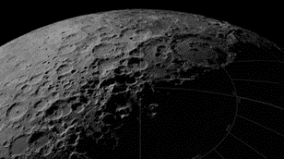
Ice
KREEP
Regolith
Excavation
Distillation
Extraction
Water
Organics
Metals
Silicon
Chemistry
CO2
N
Plastics
P
K
Machining
Fabrication
Electrolysis
Growth
Drinking Water
Parts
Equipment
Telerobots
Structures
Solar Cells
Electronics
Propellant
Sanitation
Food

Slide 34
Ice
KREEP
Regolith
Excavation
Distillation
Extraction
Water
Organics
Metals
Silicon
Chemistry
CO2
N
Plastics
P
K
Machining
Fabrication
Electrolysis
Growth
Drinking Water
Parts
Equipment
Telerobots
Structures
Solar Cells
Electronics
Propellant
Sanitation
Food

Slide 35
Ice
KREEP
Regolith
Excavation
Distillation
Extraction
Water
Organics
Metals
Silicon
Chemistry
CO2
N
Plastics
P
K
Machining
Fabrication
Electrolysis
Growth
Drinking Water
Parts
Equipment
Telerobots
Structures
Solar Cells
Electronics
Propellant
Sanitation
Food

Slide 36
Ice
KREEP
Regolith
Excavation
Distillation
Extraction
Water
Organics
Metals
Silicon
Chemistry
CO2
N
Plastics
P
K
Machining
Fabrication
Electrolysis
Growth
Drinking Water
Parts
Equipment
Telerobots
Structures
Solar Cells
Electronics
Propellant
Sanitation
Food

Slide 37
Ice
KREEP
Regolith
Excavation
Distillation
Extraction
Water
Organics
Metals
Silicon
Chemistry
CO2
N
Plastics
P
K
Machining
Fabrication
Electrolysis
Growth
Drinking Water
Parts
Equipment
Telerobots
Structures
Solar Cells
Electronics
Propellant
Sanitation
Food

Slide 38
Ice
KREEP
Regolith
Excavation
Distillation
Extraction
Water
Organics
Metals
Silicon
Chemistry
CO2
N
Plastics
P
K
Machining
Fabrication
Electrolysis
Growth
Drinking Water
Parts
Equipment
Telerobots
Structures
Solar Cells
Electronics
Propellant
Sanitation
Food

Slide 39
Sufficient Supply

Slide 40
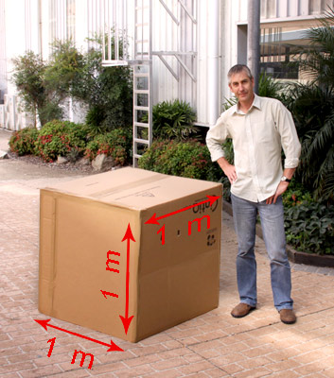
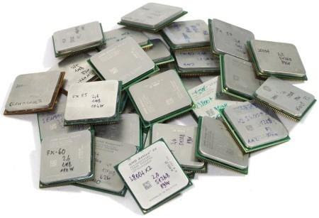
Sufficient Supply
Notes:
40

Slide 41
Sufficient Supply
Earth
independent
Base
Self-
established
sustaining
Notes:
41

Slide 42
Sufficient Supply
Earth
independent
Earth supply
Base
Self-
established
sustaining
Notes:
42

Slide 43
Sufficient Supply
Earth
independent
Earth supply
Sufficient
Sufficient
Base
Self-
supply
established
supply
sustaining
Use supplies
Earth supply
Buy time
Notes:
43

Slide 44
Sufficient Supply
Earth
independent
Earth supply
Sufficient
Base
Self-
established
supply
sustaining
Good enough
Earth supply
protocols
Notes:
44

Slide 45
Sufficient Supply
Earth
independent
Earth supply
Sufficient
Base
Self-
established
supply
sustaining
Good enough
Earth supply
protocols
Earth
independent
Notes:
45

Slide 46
How Soon Could a Base Become Completely Earth Independence?

Slide 47
How Soon Could a Base Become Completely Earth Independence?
Unclear at this point.
Need a itemization & production ideas.
Generation doubling time = 20 years.
FTEs required to double everything.
Notes:
47

Slide 48
Conclusions
Earth independence is the degree to which a base / colony doesn’t have to be supplied from Earth.
The ISRU areas are largely known with ideas for how they can be achieved.
High degrees of Earth independence is possible fairly early on.
Advantages are reduced costs and survival.
Complete Earth independence might be possible fairly early or not.
Percent mass independence is a useful measure of Earth independence.
“Sufficient supply” can result in an earlier complete independence.

Slide 49
Thank you for your attention
DOUG PLATA MD, MPH
President & Founder,
The Space Development Network
SpaceDevelopment.org
DevelopSpace1@gmail.com

