Slide 1
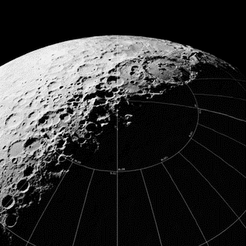
Earth Independence:
Meat, Nutrition and Culinary Arts
Chris Wolfe
The Space Development Network
SpaceDevelopment.org
Christopher.Wolfe.Public@gmail.com

Slide 2
Overview
What are the essential requirements for a healthy diet?
How do we choose what to grow?
Can we raise animals?
Bringing our food culture to space.

Slide 3
Requirements for a Healthy Diet
Macronutrients
USDA guidelines, active woman, 63kg
2085 calories, 109g protein, 270g carbs, 60g fat
USDA guidelines, active man, 71kg
2630 calories, 138g protein, 340g carbs, 76g fat
Notes:
‹#›

Slide 4
Requirements for a Healthy Diet
Minerals, Vitamins, Traces
Iron, Calcium, Potassium, Phosphorus, Magnesium, Sodium
A, B complex, C, D, E, K
Fluoride, Zinc, Copper, Manganese
Notes:
‹#›

Slide 5
Requirements for a Healthy Diet
Amino Acids:
All nine essential amino acids balanced (arginine is only essential for children)
Nine conditional amino acids present (several not tracked in USDA database)
Notes:
‹#›

Slide 6
Requirements for a Healthy Diet
Minimally processed vegan diet gaps:
Calcium: kale, ~2 servings
B12: Chlorella powder, 10-20 g
D: UV-exposed mushrooms, ½ to 2 servings
Methionine: supplements, extracts or animals
Notes:
‹#›

Slide 7
Choosing What to Grow
Old way: maximize efficiency
New way: balance productivity with desirability
Variety and tradition are important too
Notes:
‹#›

Slide 8
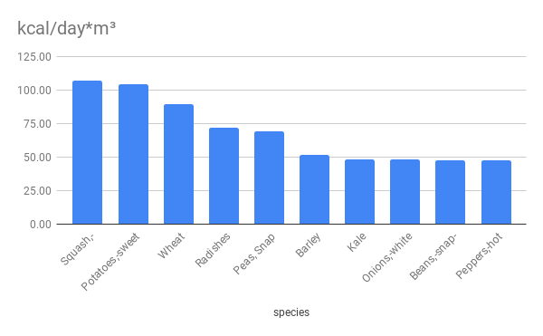
Choosing What to Grow
Efficient calorie producers:
Notes:
‹#›

Slide 9
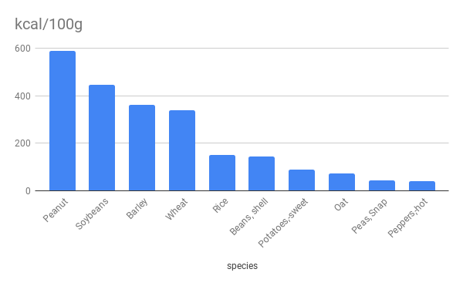
Choosing What to Grow
Dense calorie producers:
Notes:
‹#›

Slide 10
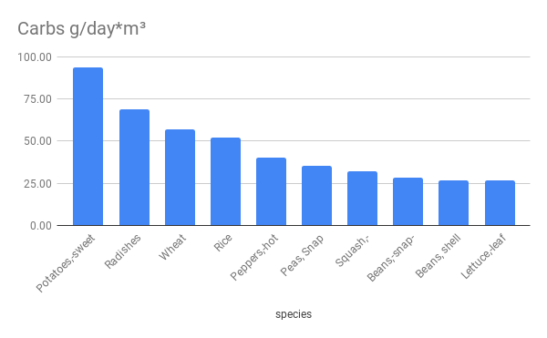
Choosing What to Grow
Efficient carbohydrate producers:
Notes:
‹#›

Slide 11
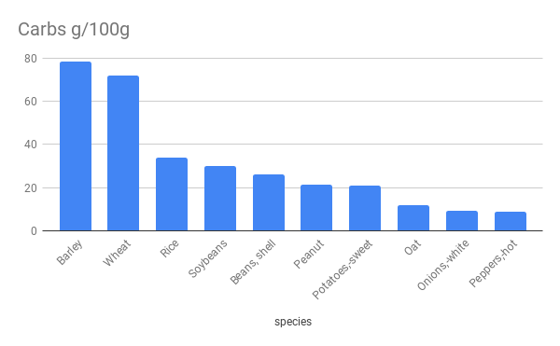
Choosing What to Grow
Dense carbohydrate producers:
Notes:
‹#›

Slide 12
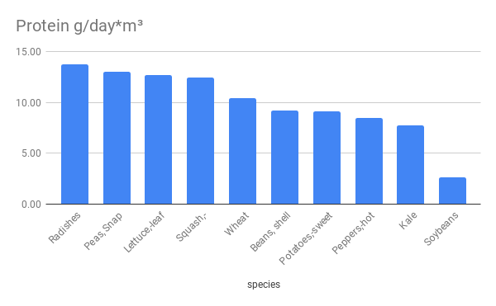
Choosing What to Grow
Efficient protein producers:
Notes:
‹#›

Slide 13
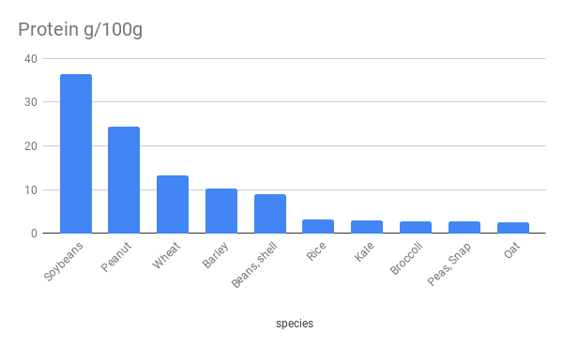
Choosing What to Grow
Dense protein producers:
Notes:
‹#›

Slide 14
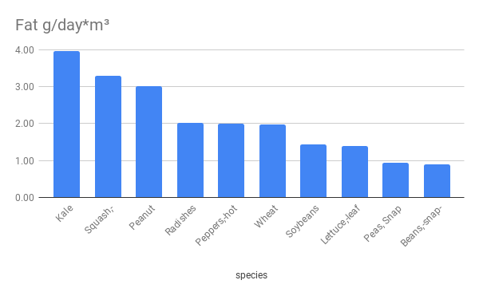
Choosing What to Grow
Efficient fat producers:
Notes:
‹#›

Slide 15
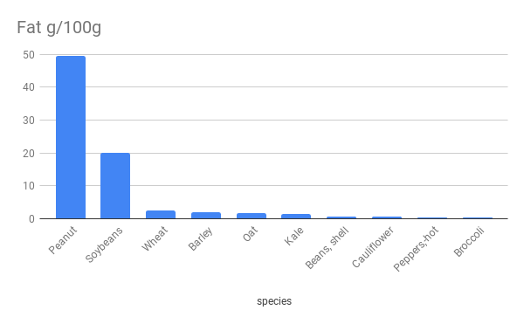
Choosing What to Grow
Dense fat producers:
Notes:
‹#›

Slide 16
Choosing What to Grow
Staple Crops: 1-2 servings daily
Lettuce, Wheat, Sweet Potato, Kale
Barley, Squash, Snap Beans, Snap Peas
Variety Crops: 0.5-1 serving daily
Onion, Strawberry, Carrot, Tomato, Radish
Cauliflower, Broccoli, Dry Beans, Rice
Trace Crops: Less than half a serving daily
Peanut, Bell Pepper, Hot Pepper
Garlic, Basil, etc.
Notes:
‹#›

Slide 17
Choosing What to Grow
Excess Crops:
Storable foods preserved as contingency supplies
Desirable foods exported
Otherwise wasted produce used to improve animal feed
Extracts used for industrial purposes
Recreational fermentation byproducts
Bioplastics
Notes:
‹#›

Slide 18
Raising Animals
Species selection
Making animal feed
Dealing with wastes
Sustainable group sizes
Notes:
‹#›

Slide 19
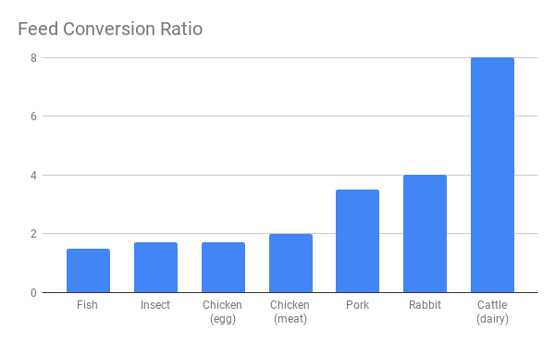
Raising Animals
Notes:
‹#›

Slide 20
Raising Animals
Fish
FCR: Good, ~1.5
Edible portion: OK, 28% to 33%
Food: 36% protein; algae, harvest waste
Species: Nile tilapia, channel catfish, Arctic char
Notes:
‹#›

Slide 21
Raising Animals
Chicken
FCR: Good, ~1.5 (eggs) to 2.0 (meat)
Edible portion: 89% (eggs) or 34% (meat)
Food: 21% protein; algae, insects, harvest waste
Notes:
‹#›

Slide 22
Raising Animals
Cattle
FCR: 0.67 for milk, 6-7 for cheese, 8+ for beef
Edible portion: 40% (beef)
Food: 16% protein; harvest waste with supplements
Notes:
‹#›

Slide 23
Raising Animals
Pork
FCR: 3.5
Edible portion: 37%
Food: 16-20% protein; harvest waste with supplements
Notes:
‹#›

Slide 24
Raising Animals
Pets?
Dog food similar to pig feed
Cat food similar to fish feed
Could be done, involves risks, valuable data
Notes:
‹#›

Slide 25
Raising Animals
Sustainable populations
Numbers depend on assumptions
6-person crew = 25 chickens, ~370 fish and periodic restocking from Earth
5,000 colonists = 110-130 cattle, 20k chickens; will require genetic imports for cattle breeding
Notes:
‹#›

Slide 26
Culinary Traditions
Bringing people together
Continuing our cultures
Combining tradition with experimentation
Developing new food culture in space
Notes:
‹#›

Slide 27
Culinary Traditions
Pie is good.
Trees are possible. Fruits yield more than nuts.
Spices are hard but high-impact.
Coffee, tea and chocolate are major investments.
Honey is the Everest of space food.
Notes:
‹#›

Slide 28
Conclusions
Complete nutrition from hydroponics is possible
Permanent outposts need more than just productivity
Animals make sense if waste streams are repurposed
We can bring more than just ourselves to space; our traditions and cultures bring humanity with us.
Independence means much more than survival.

