Slide 1
The Moon-Mars Analogue Base
Presented by: Christian B. Meza
President of the Tucson L5 Space Society

Slide 2
Overview
The status of AEI development
Getting the ball rolling
The Space Development Network
A new type of analogue base
The role of everyday people
What can be done before ISDC 2020

Slide 3
The Status of AEI Development

Slide 4
The Status of AEI Development
o Air pressure
o Sufficient gravity
o Oxygen
o Temperature
o Information
o Power
o Radiation
o Water
o Genetics
o Food
o Isolation
o Hardware
o Translocation
o Sanitation
o Electronics
Notes:
4

Slide 5
The Status of AEI Development
x
x
o Air pressure
o Sufficient gravity
x
o Oxygen
x
x
o Temperature
o Information
x
x
o Power
o Radiation
x
x
o Water
o Genetics
x
o Food
x
o Isolation
x
x
o Hardware
o Translocation
x
x
o Sanitation
o Electronics
Notes:
5

Slide 6
Moving the Ball Forward

Slide 7
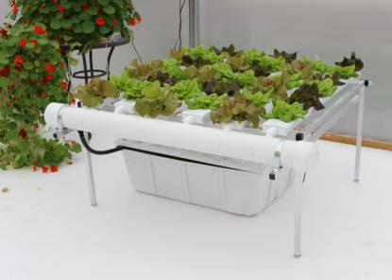
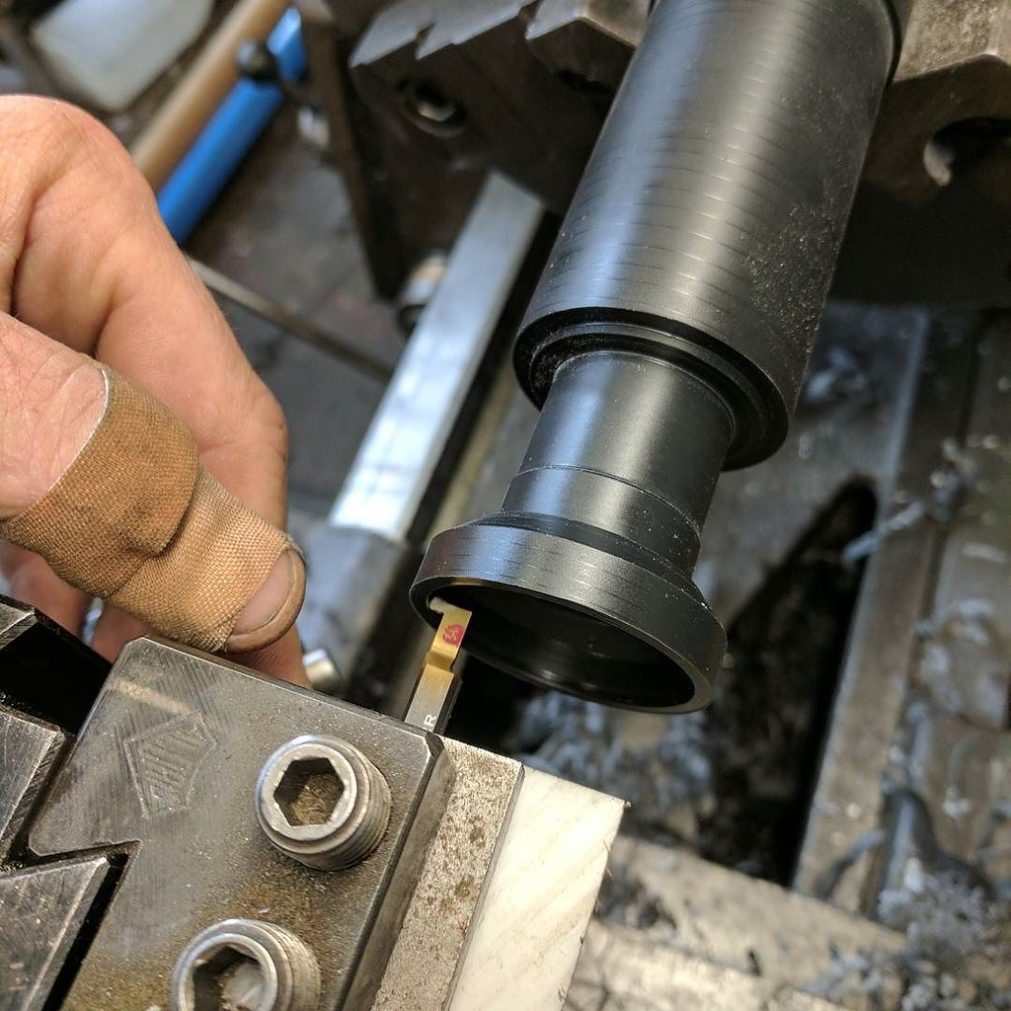
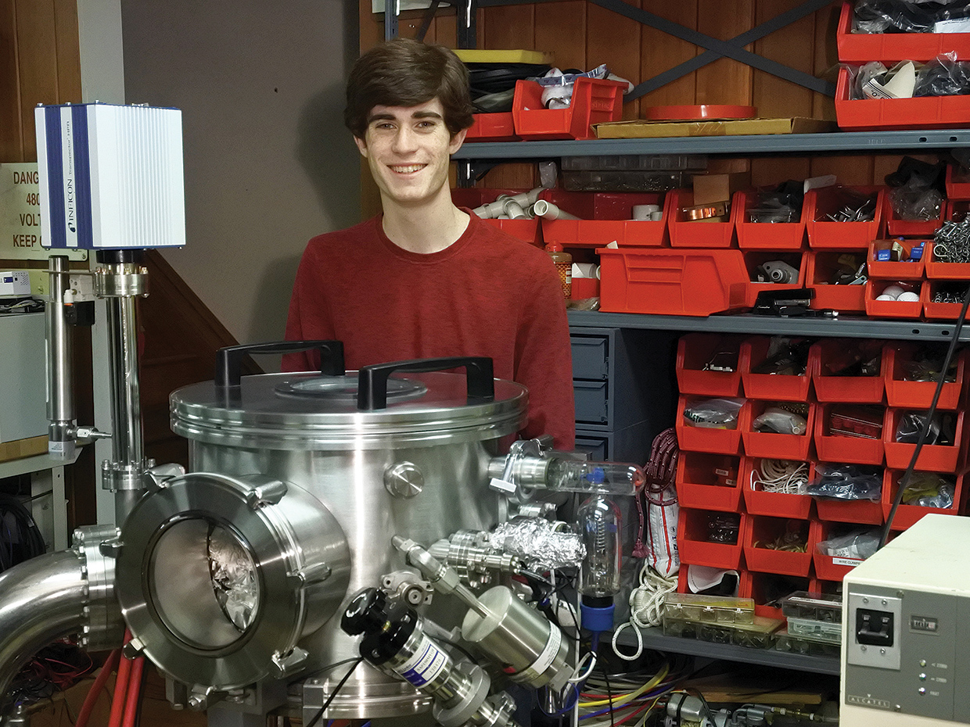
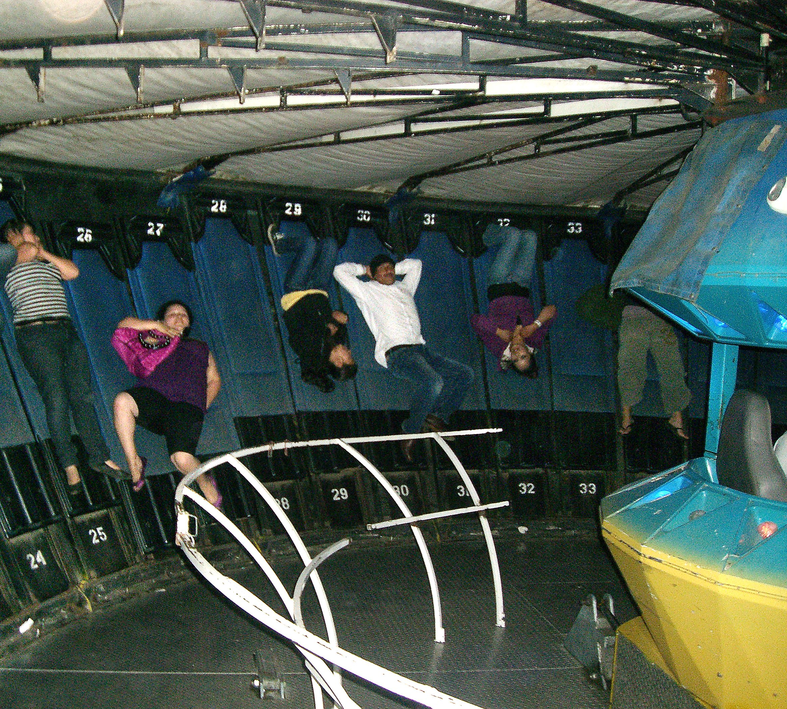
Moving the Ball Forward

Slide 8
The Space Development Network

Slide 9
The Space Development Network
Notes:
9

Slide 10
A New Type of Analogue Base

Slide 11
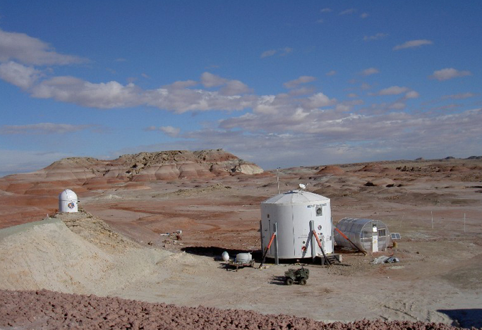
Why Another Analogue Base?
Moon & Mars
Notes:
11

Slide 12
Why Another Analogue Base?
Exploration
vs Development / Settlement
Notes:
12

Slide 13
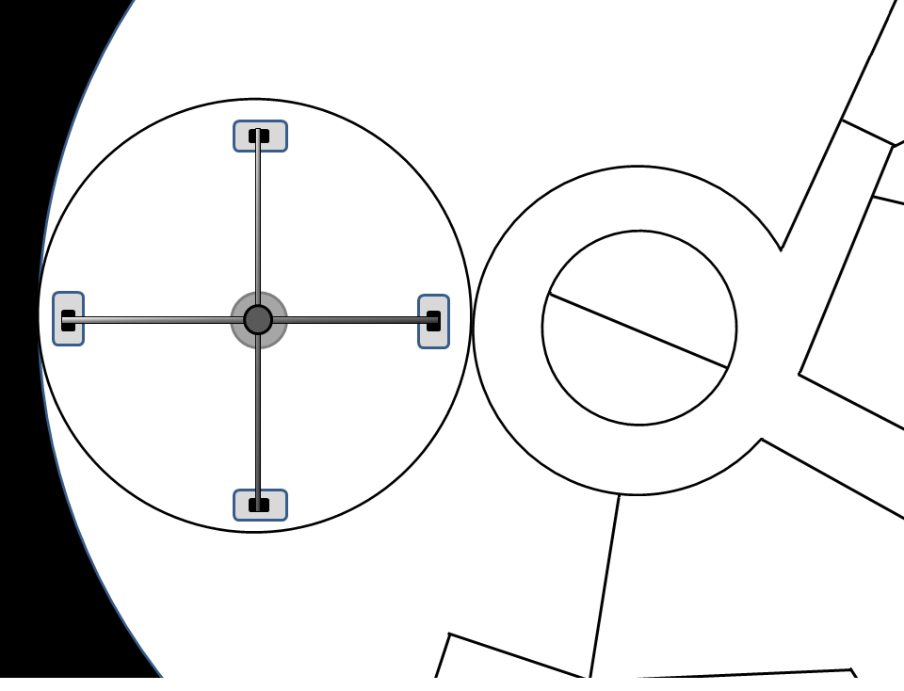
Why Another Analogue Base?
Notes:
13

Slide 14
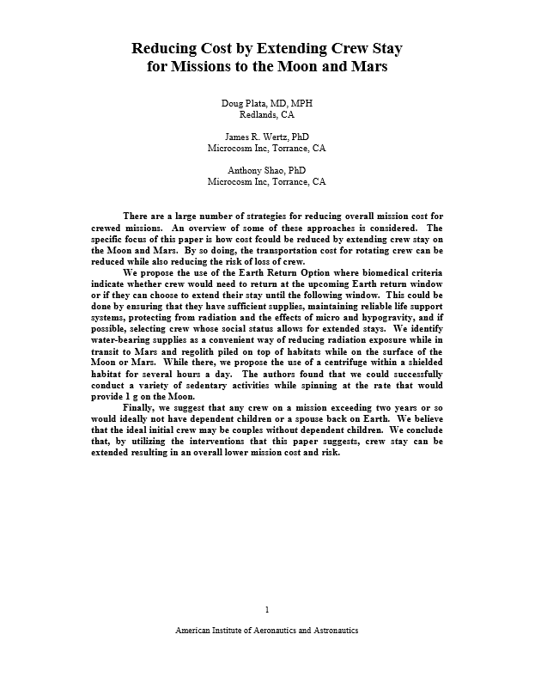
Why Another Analogue Base?
Notes:
14

Slide 15
Proposal: The Moon-Mars Analogue Base

Slide 16
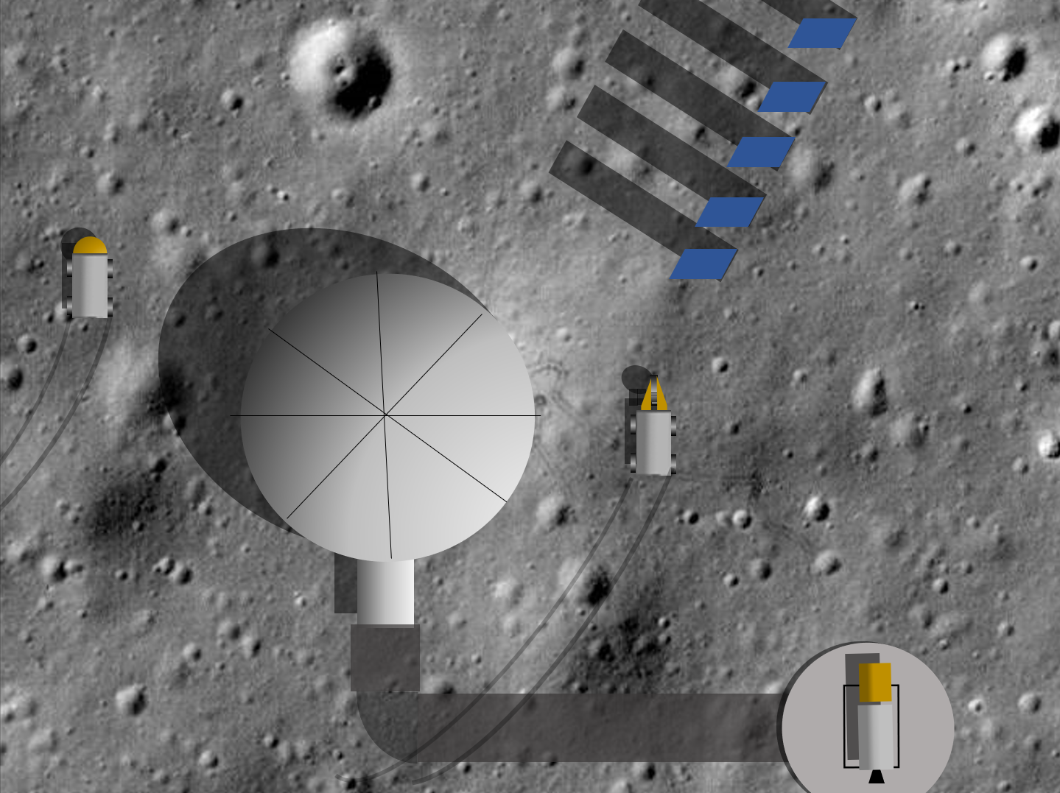
Terms
Moon-Mars Analogue Base (MMAB)
Notes:
16

Slide 17
The UniHab

Slide 18
UniHab
DevelopSpace.org
Notes:
18

Slide 19
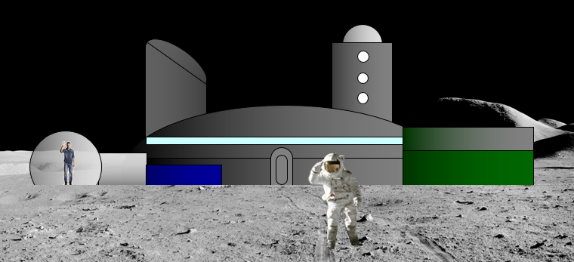
UniHab
Notes:
19

Slide 20
UniHab
Notes:
20

Slide 21
Hydroponic Greenhouse
Notes:
21

Slide 22
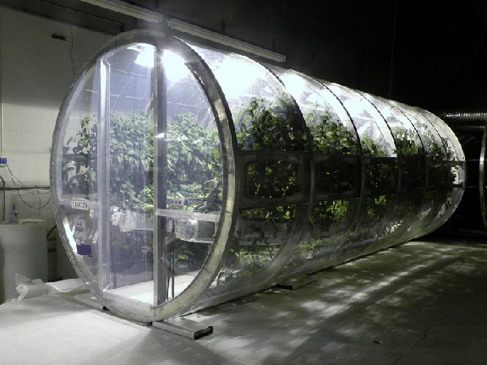
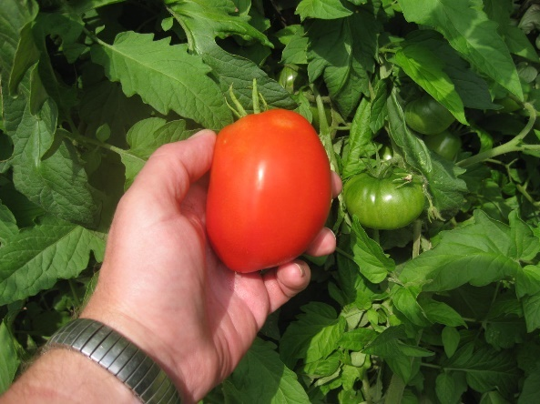
Hydroponic Greenhouse
Notes:
22

Slide 23
Aquaponics
Notes:
23

Slide 24
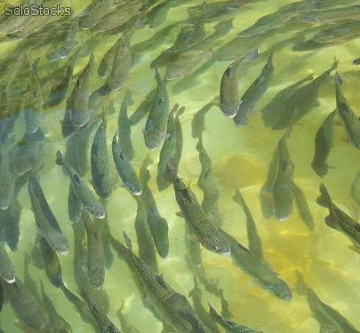
Aquaponics
Notes:
24

Slide 25
Centrifuge
Notes:
25

Slide 26
Centrifuge
Notes:
26

Slide 27
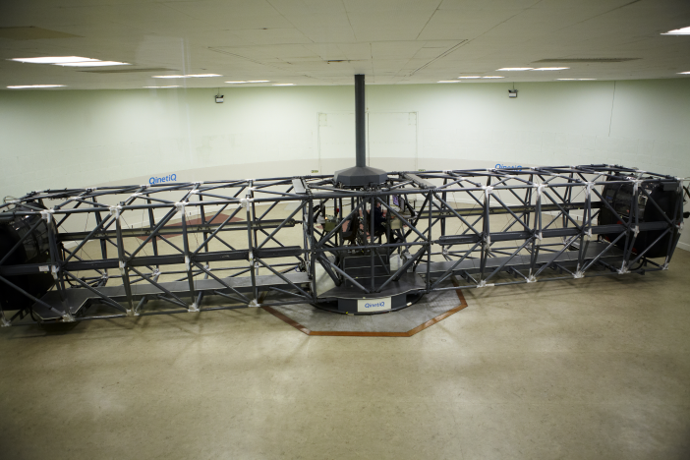
Centrifuge
Notes:
27

Slide 28
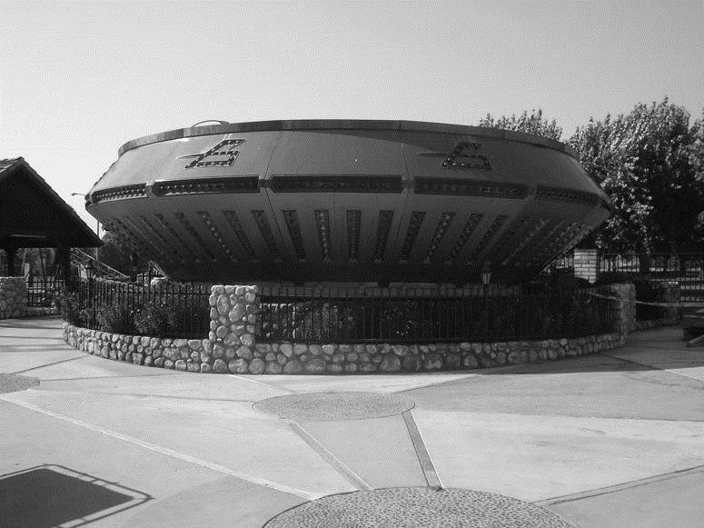
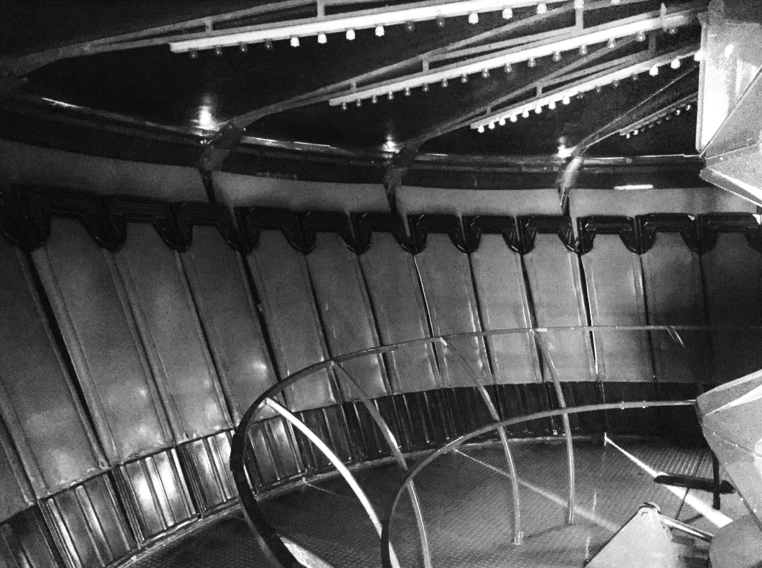
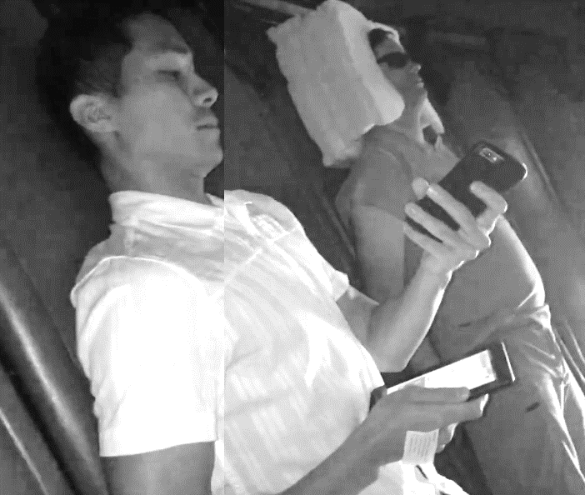
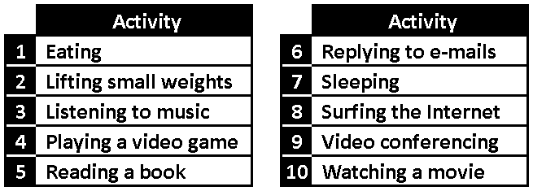
Centrifuge
Notes:
28

Slide 29
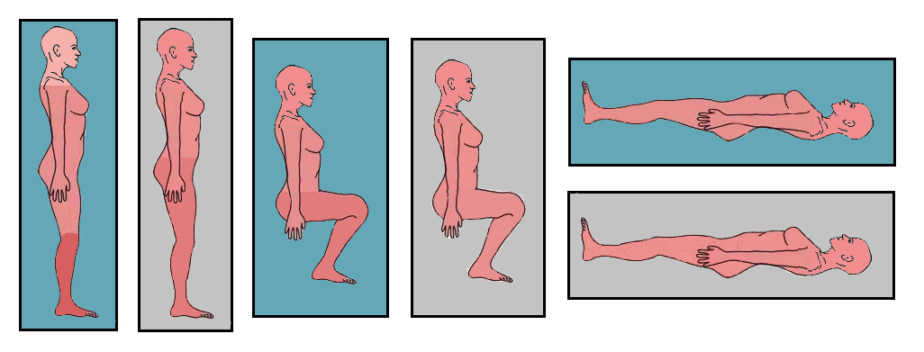
Centrifuge
Notes:
29

Slide 30
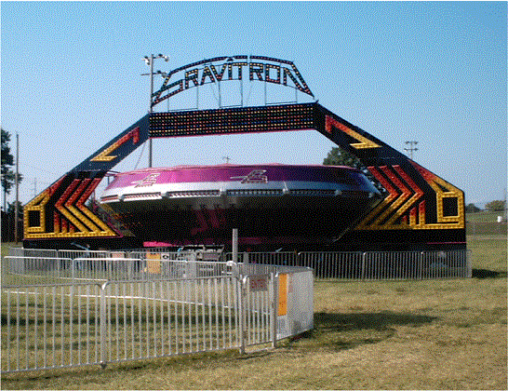
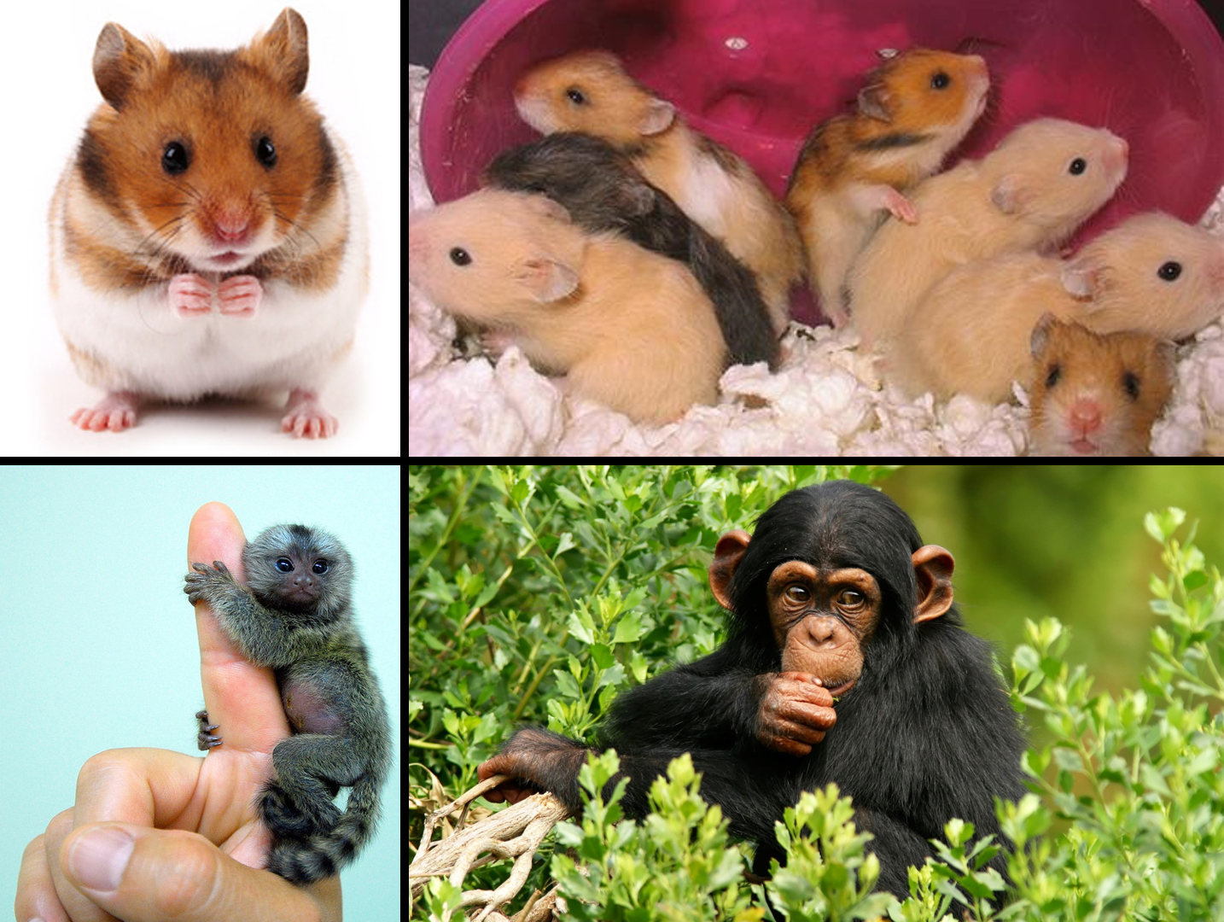
Centrifuge
Notes:
30

Slide 31
Other Areas
Notes:
31

Slide 32
Bedrooms
Notes:
32

Slide 33
Lunar Base
Notes:
33

Slide 34
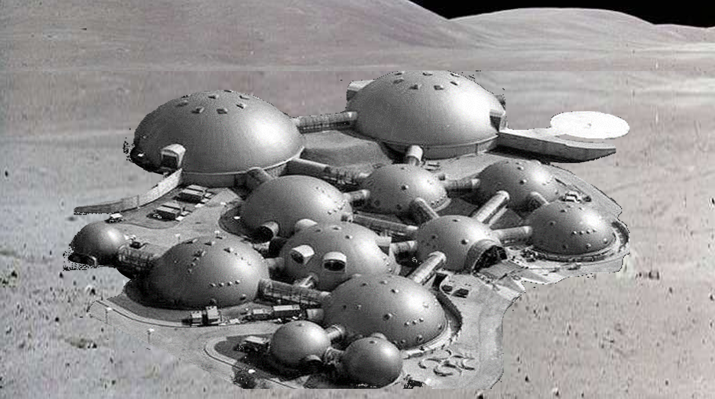
Lunar Base
Notes:
34

Slide 35
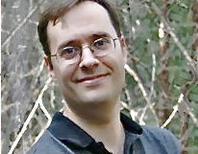
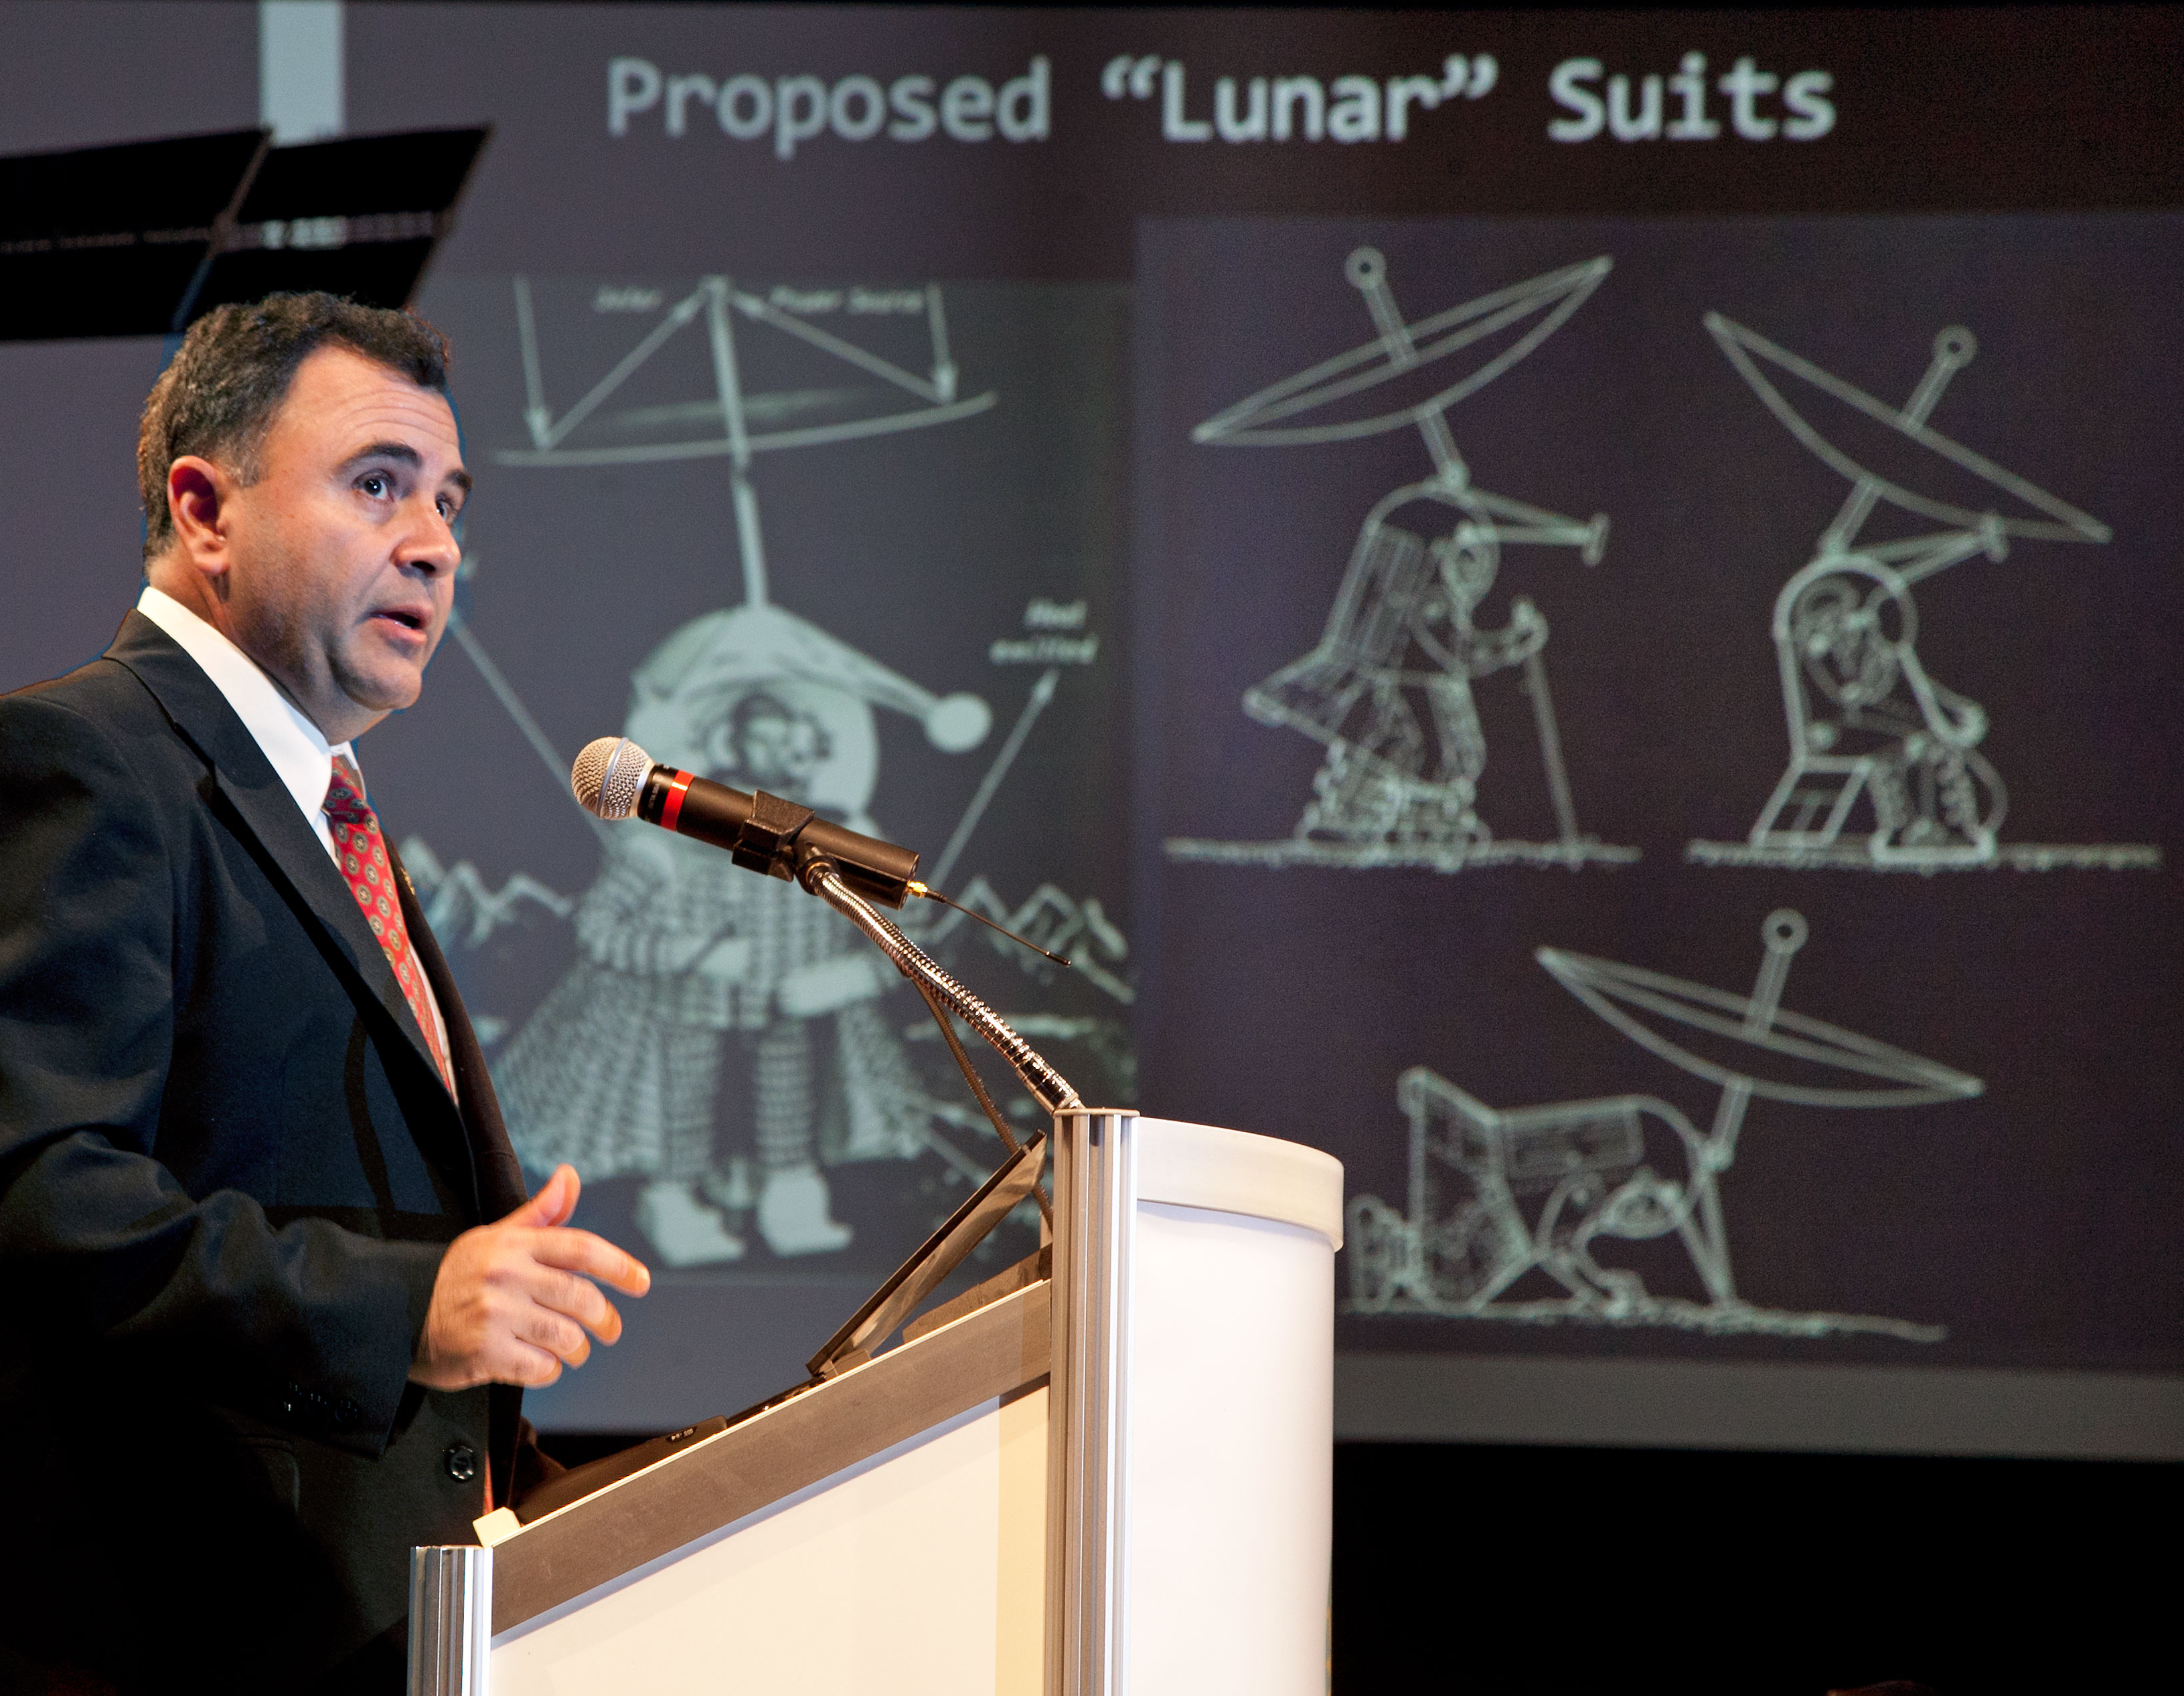
Partnerships
MMAB
Notes:
35

Slide 36
Tucson L5 Space Society
Design
Set-up
Electrical
Fundraising
Furnishings
Greenhouse
Aquaponics
Centrifuge
Animals
Public events
Simulations
Virtual reality
Culinary
Music
Dance
Art
Teaching
A.G. Rx
Power systems
Spacesuits
Communications
Metallurgy
Machining
Telerobotics
Chemistry
Geology
Reproduction
Notes:
36

Slide 37
Local Supporters
Design
Set-up
Electrical
Fundraising
Furnishings
Greenhouse
Aquaponics
Centrifuge
Animals
Public events
Simulations
Virtual reality
Culinary
Music
Dance
Art
Teaching
A.G. Rx
Power systems
Spacesuits
Communications
Metallurgy
Machining
Telerobotics
Chemistry
Geology
Reproduction
Notes:
37

Slide 38
University of Arizona
Design
Set-up
Electrical
Fundraising
Furnishings
Greenhouse
Aquaponics
Centrifuge
Animals
Public events
Simulations
Virtual reality
Culinary
Music
Dance
Art
Teaching
A.G. Rx
Power systems
Spacesuits
Communications
Metallurgy
Machining
Telerobotics
Chemistry
Geology
Reproduction
Notes:
38

Slide 39
Distant Supporters
Design
Set-up
Electrical
Fundraising
Furnishings
Greenhouse
Aquaponics
Centrifuge
Animals
Public events
Simulations
Virtual reality
Culinary
Music
Dance
Art
Teaching
A.G. Rx
Power systems
Spacesuits
Communications
Metallurgy
Machining
Telerobotics
Chemistry
Geology
Reproduction
Notes:
39

Slide 40
Kickstarter Campaign(s)
INITIAL UNIHAB
Structural & Electrical
electronics & airlocks
Inflatable furniture
Hydroponic plants
Fish tank
Kitchen
Centrifuge
Chemistry equipment
Metallurgy / Machining
Medical equipment
OUTDOORS
Lander
Solar drapes
Ice harvester
Telerobot
CREW
Space suits
Crewed rover
PR
EXPANSION
ILRB
Farm module
Outdoor module
Hotel Luna
Copies for different locations
Machine shop
Life support systems
OTHER
Notes:
40

Slide 41
Earth Independence:
Goals for the Next ISDC

Slide 42
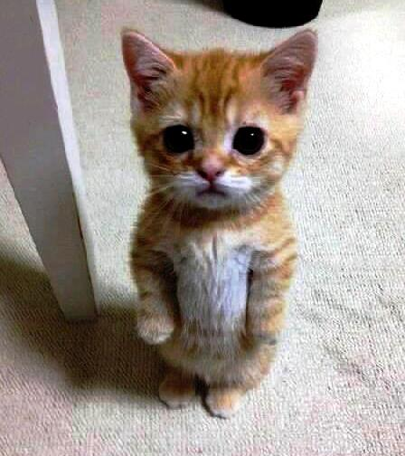
Thank you for your attention

