Slide 1
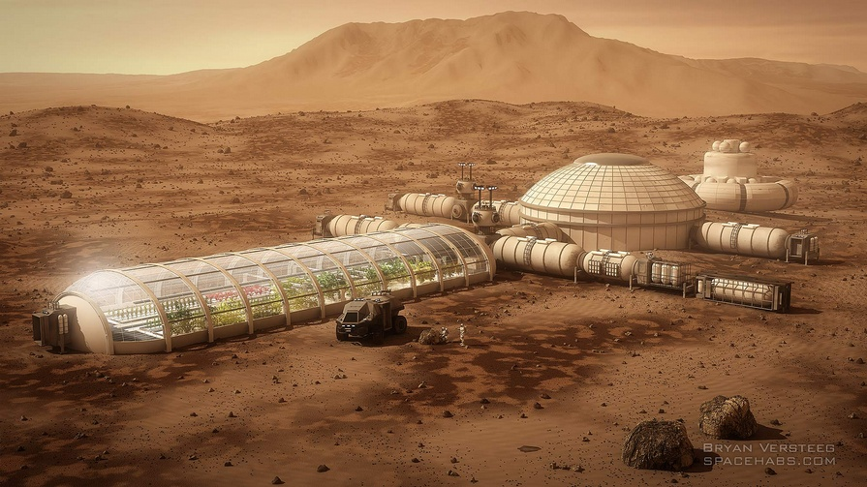
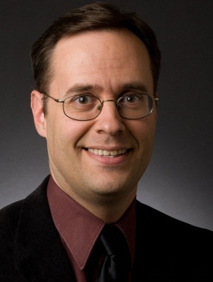
Providing for the Medical Needs of a Growing Base
DOUG PLATA MD, MPH
Space Development Network
DougSpace007@gmail.com
909-557-7483

Slide 2
Overview
Notes:
2

Slide 3
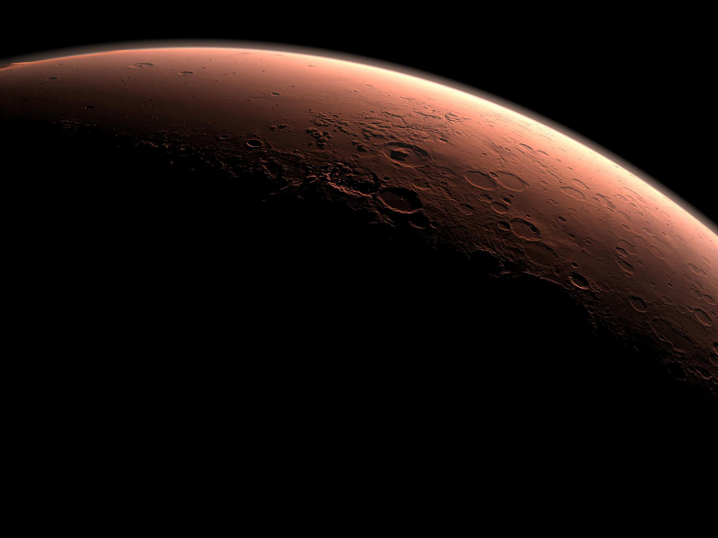
Overview
Four crew phases
Prevention / screening
Emergency rescue
Medical facilities
Medical & other providers
Medications
l
l
l
l
l
l
Notes:
3

Slide 4
Phases
Notes:
4

Slide 5
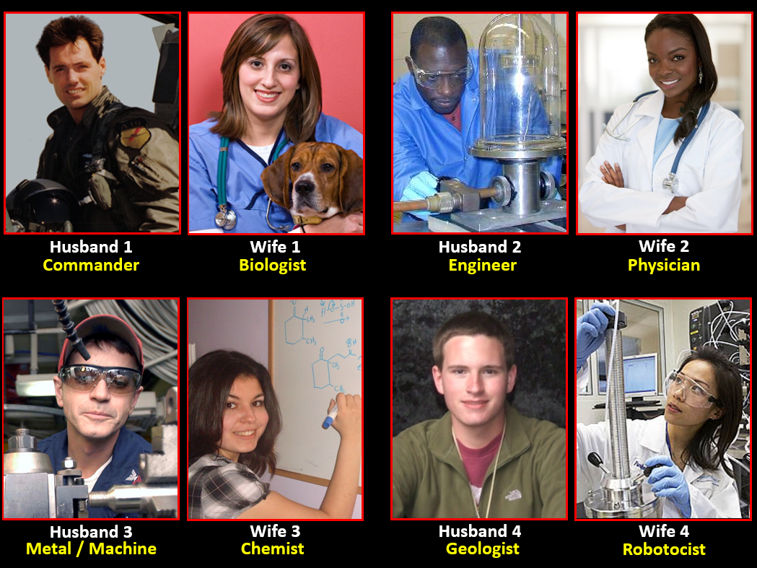
Initial Team
Notes:
5

Slide 6
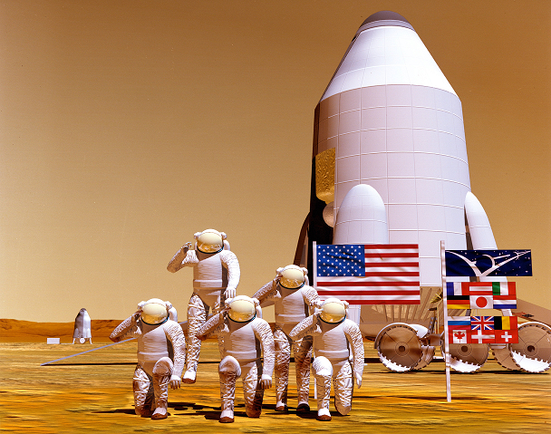
International Mars Exploration

Slide 7
Initial Private Settlers

Slide 8
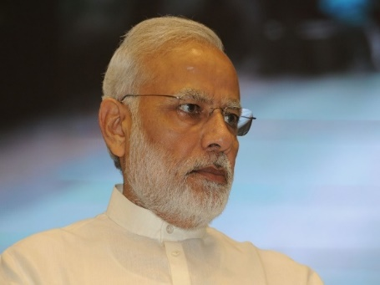
Later Private Settlers

Slide 9
Prevention / Screening
Notes:
9

Slide 10
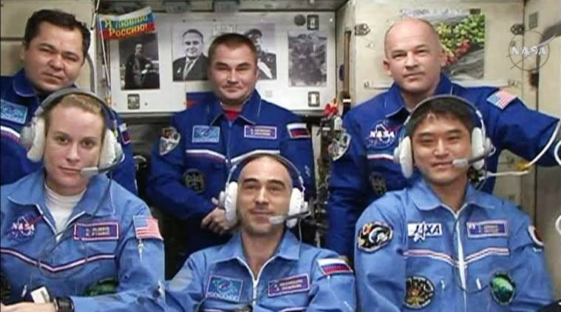
Initial & International Crew

Slide 11
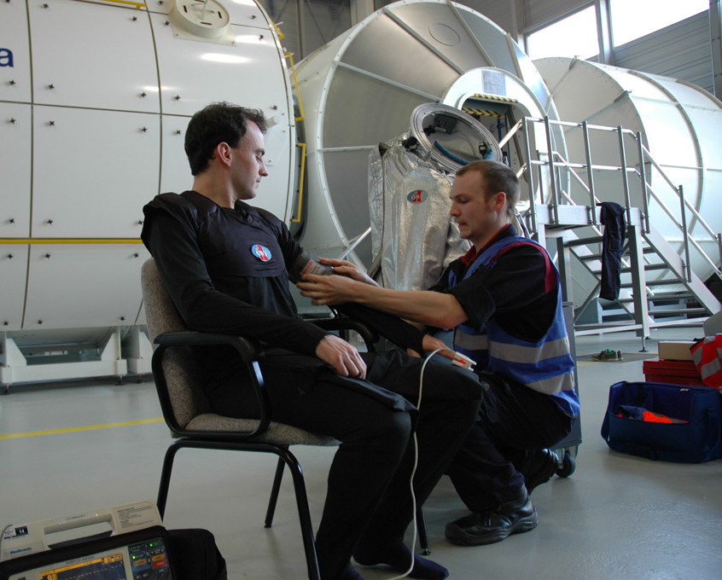
Initial & International Crew

Slide 12
Initial Private Settlers

Slide 13
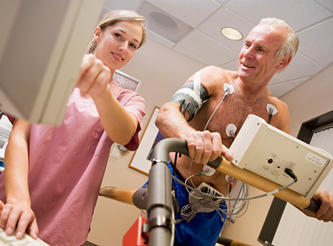
Initial Private Settlers

Slide 14
Later Private Settlers

Slide 15
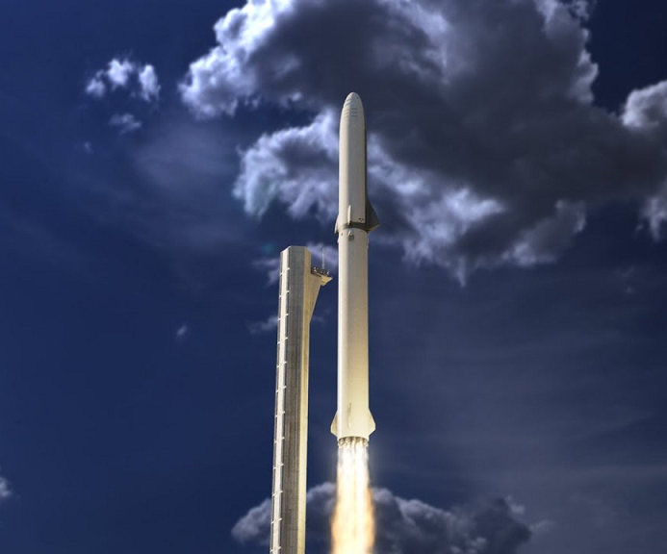
Later Private Settlers

Slide 16
Emergency Rescue
Notes:
16

Slide 17
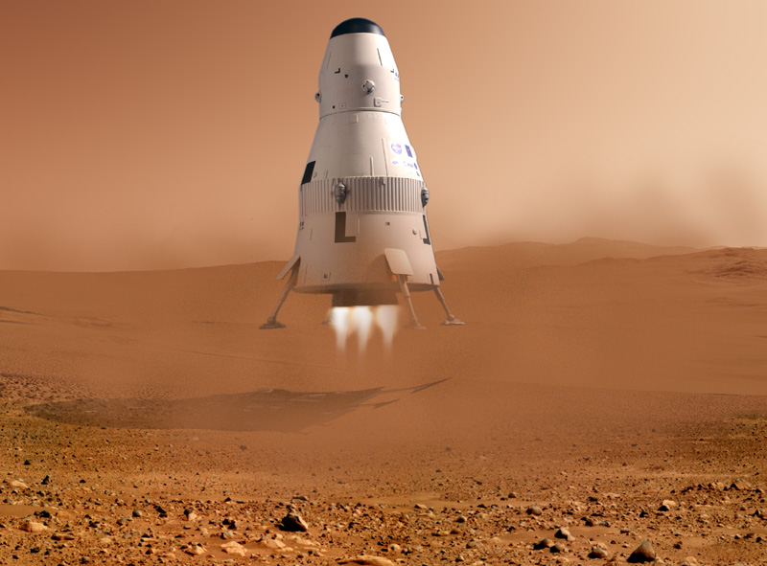
Emergency Rescue

Slide 18
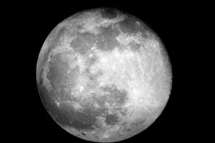
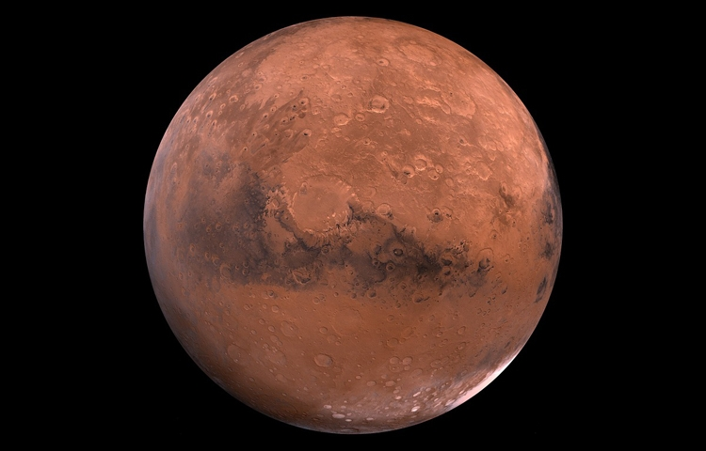
Emergency Return

Slide 19
Medical Facilities
Notes:
19

Slide 20
Initial Crew

Slide 21
Initial Crew

Slide 22
International Astronauts

Slide 23
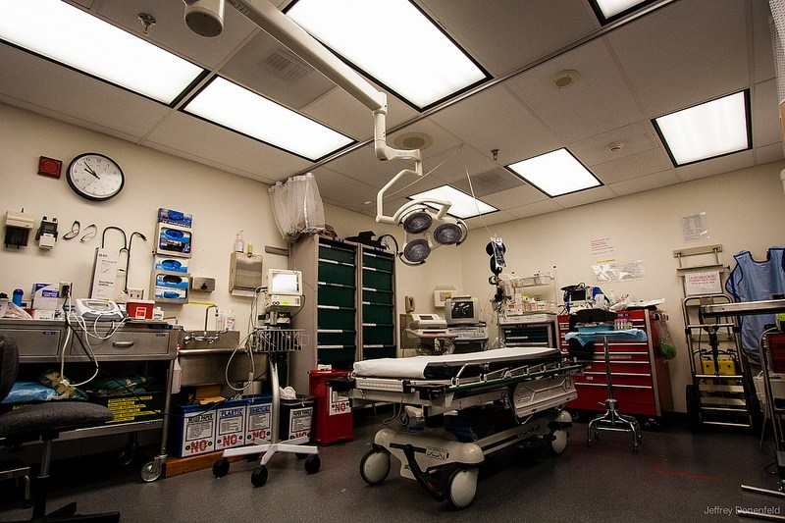
International Astronauts

Slide 24
Initial Private Settlers

Slide 25
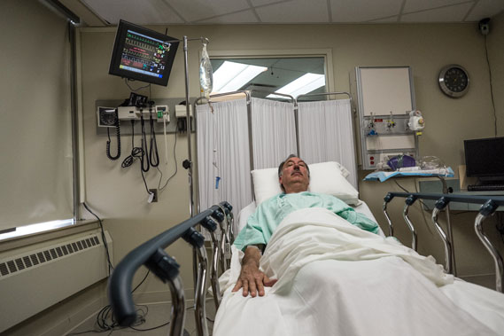
Initial Private Settlers

Slide 26
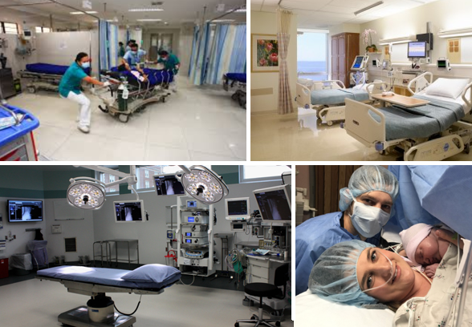
Later Private Settlers

Slide 27
Nursing Homes
Notes:
27

Slide 28
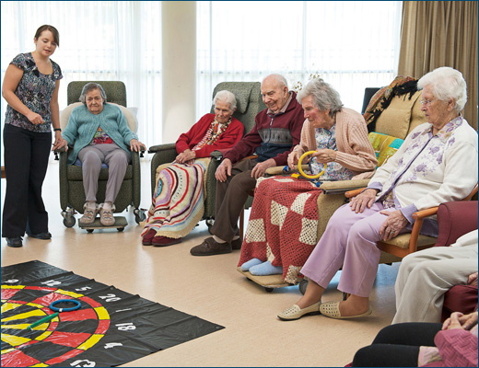
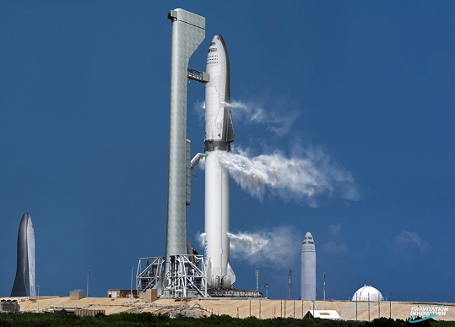
Nursing Homes

Slide 29
Nursing Homes

Slide 30
Medical Providers
Notes:
30

Slide 31
Initial Crew

Slide 32
Initial Crew

Slide 33
Initial Crew

Slide 34
International Astronauts

Slide 35
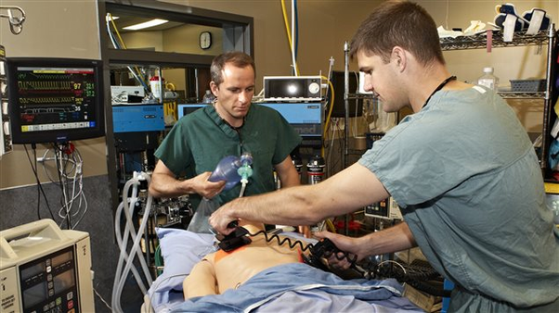
International Astronauts

Slide 36
Initial Private Settlers

Slide 37
Initial Private Settlers

Slide 38
Initial Private Settlers

Slide 39
Later Private Settlers

Slide 40
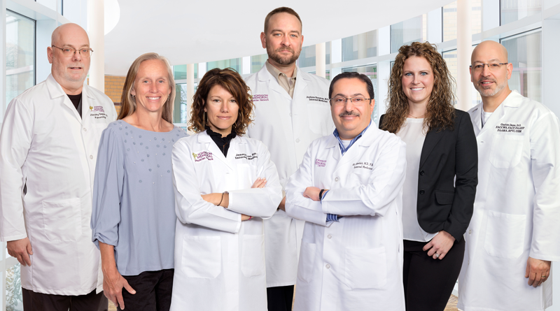
Later Private Settlers

Slide 41
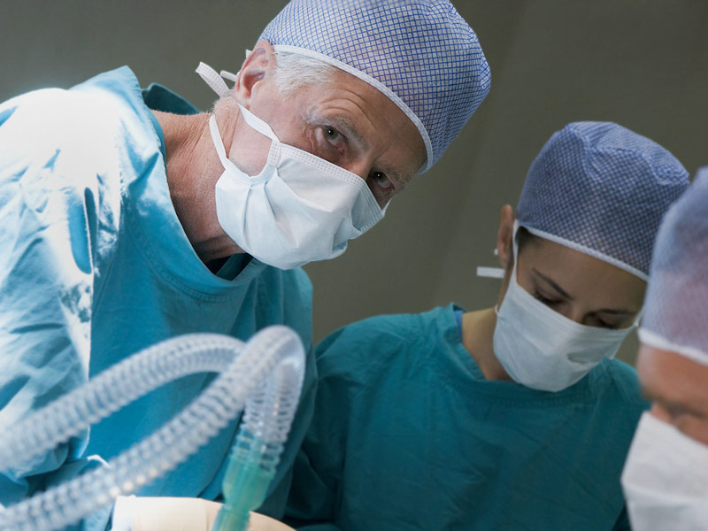
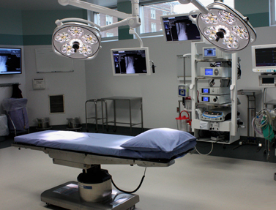
Surgeries

Slide 42
Dentistry
Notes:
42

Slide 43
Initial Crew

Slide 44
Later

Slide 45
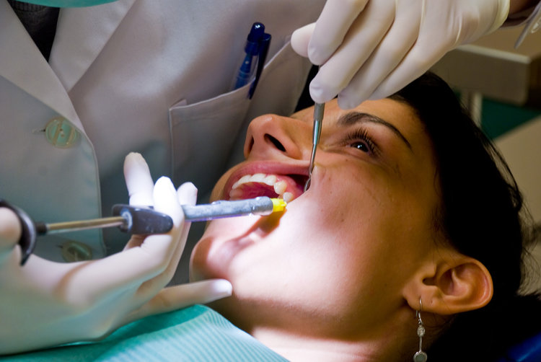
Later

Slide 46
Allied Health
Notes:
46

Slide 47
Allied Health

Slide 48
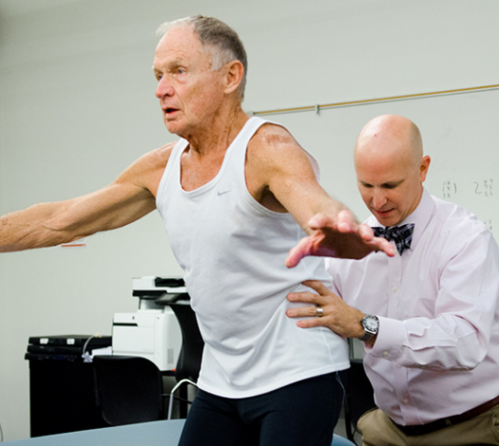
Allied Health

Slide 49
Medications
Notes:
49

Slide 50
Initial Crew

Slide 51
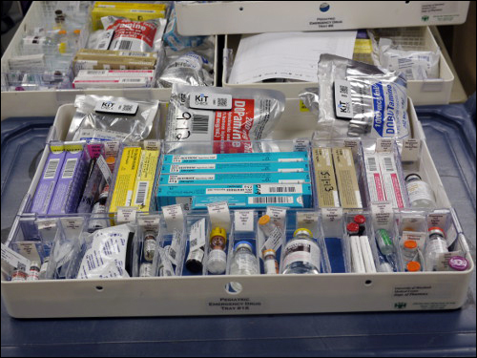
Initial Crew

Slide 52
International Astronauts

Slide 53
International Astronauts

Slide 54
Initial Private Settlers

Slide 55
Initial Private Settlers

Slide 56
Later Private Settlers

Slide 57
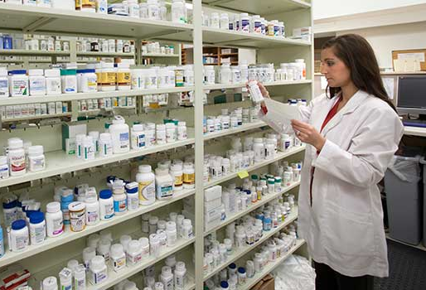
Later Private Settlers

Slide 58
Producing Medications

Slide 59
Producing Medications

Slide 60
Producing Medications
Foxglove - Digoxin

Slide 61
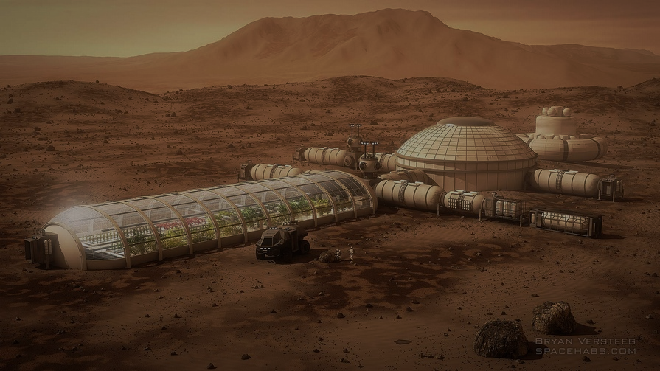
Thank you for your attention
DOUG PLATA MD, MPH
Space Development Network
DougSpace007@gmail.com
909-557-7483

