Slide 1
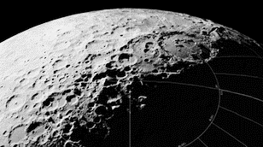
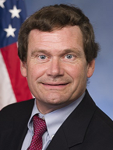
Earth Independence: Producing Habitats
ART HARMAN
Position
Affiliation
SpaceDevelopment.org

Slide 2
Shackleton Crater

Slide 3
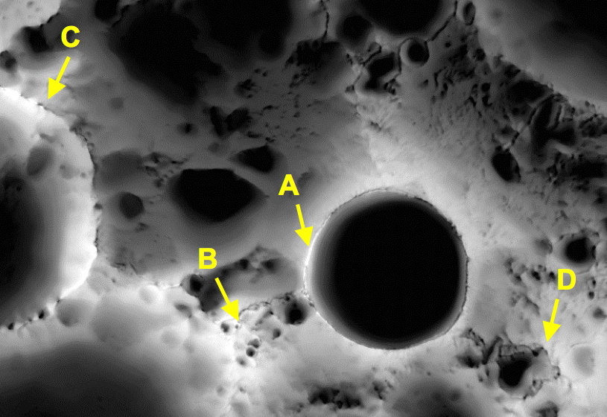
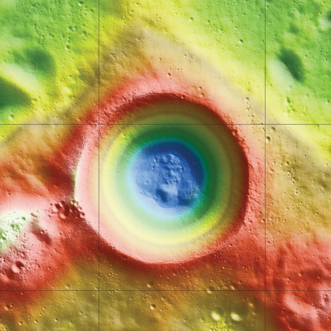
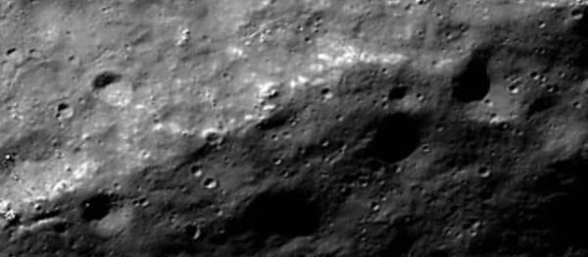
Locating the Hab & Base
Concept for traverse path between sunlit peaks
Shackleton Crater (NASA – LRO)
Rim of Shackleton Crater south pole (NASA – LRO)
Notes:
3

Slide 4
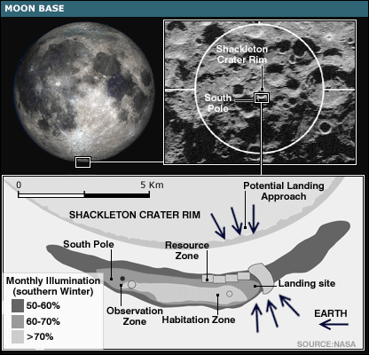
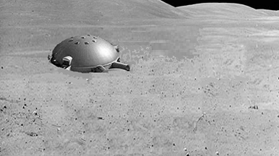
Locating the Hab & Base
Shackleton base concept (NASA)
Notion of an initial lunar base

Slide 5
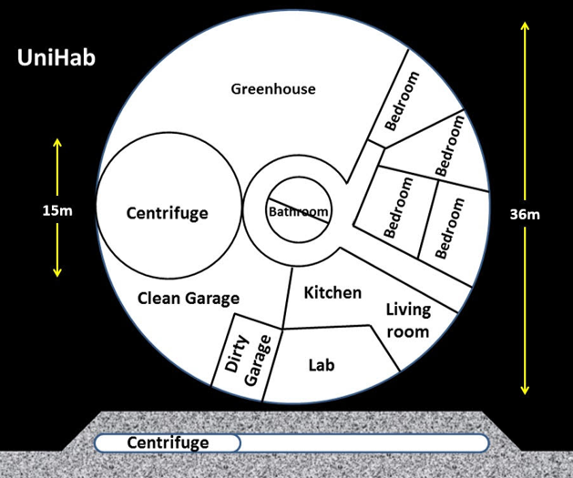
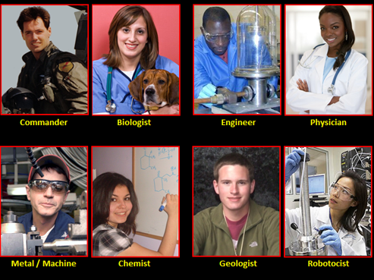
Initial Hab & Team
UniHab concept (Plata)
Concept of an initial, permanent, lunar crew and their jobs

Slide 6
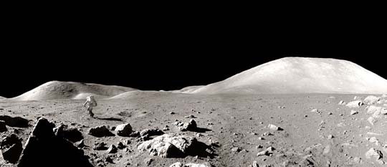
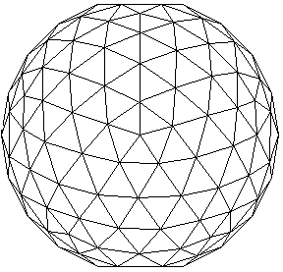
Initial Hab & Team
Lunar base concept – Bird’s eye view
Lunar base concept – Surface view

Slide 7
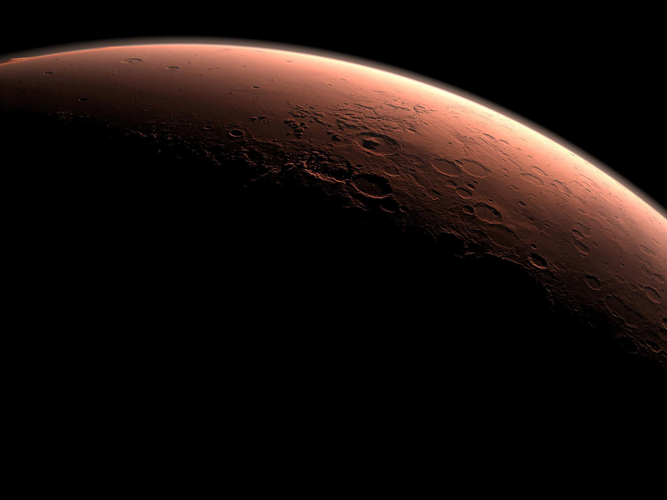
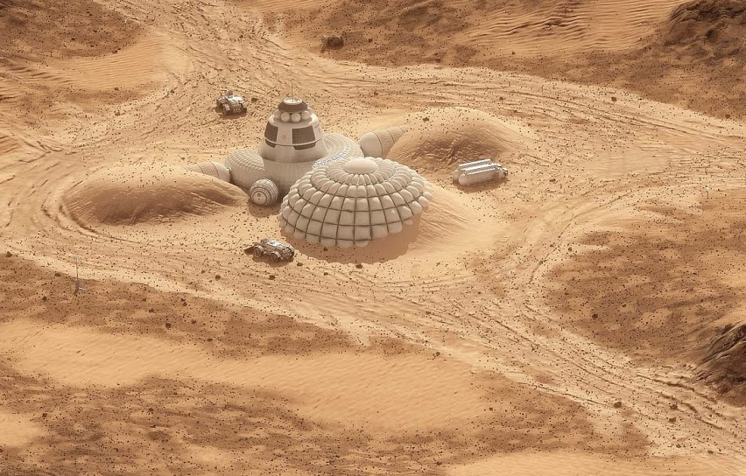
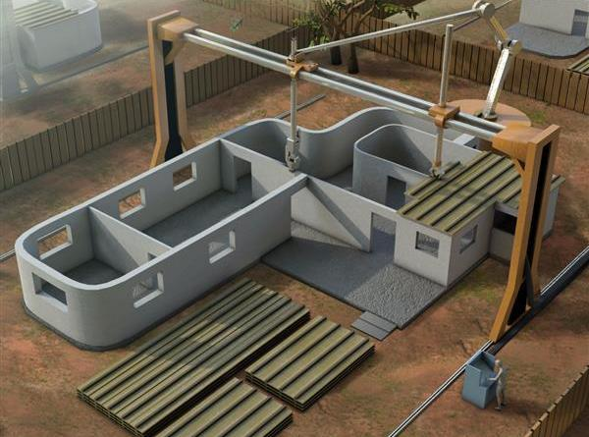
Inflatables vs 3D Printing
Inflatables
ISRU Construction
Notes:
7

Slide 8
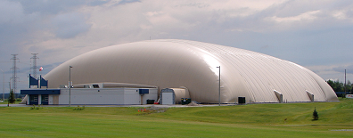
Advantages of Inflatables
Very large volume

Slide 9
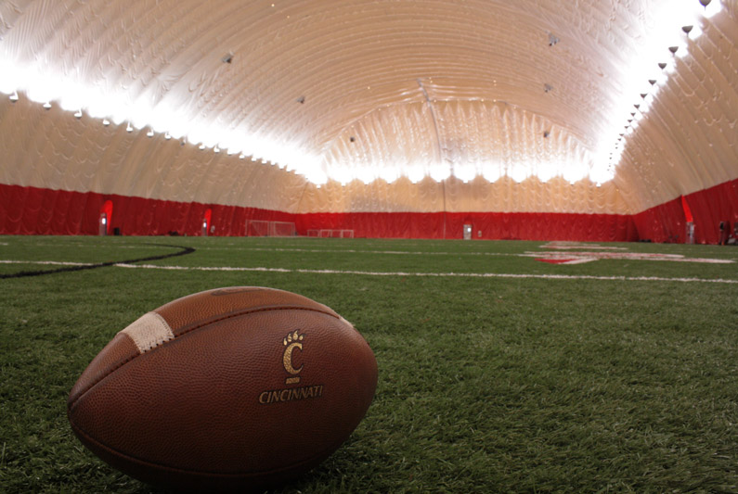
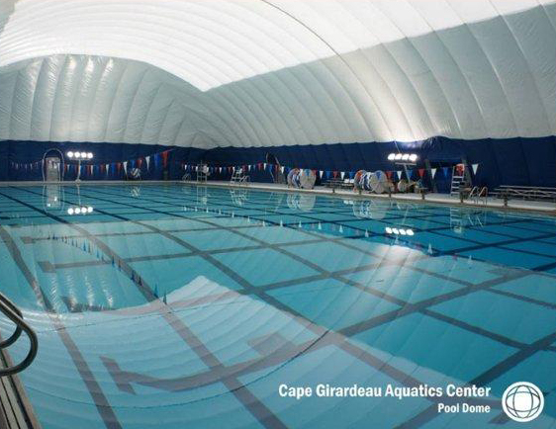
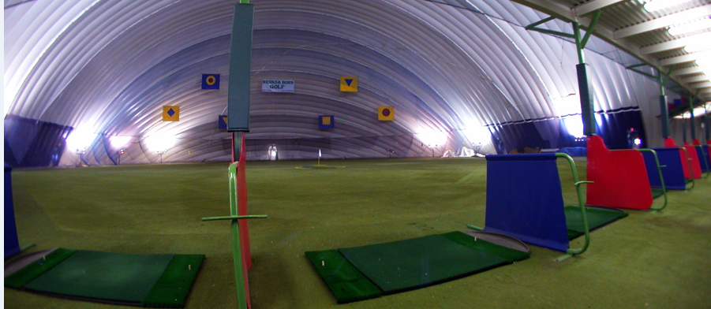
Very Large Inflatables

Slide 10
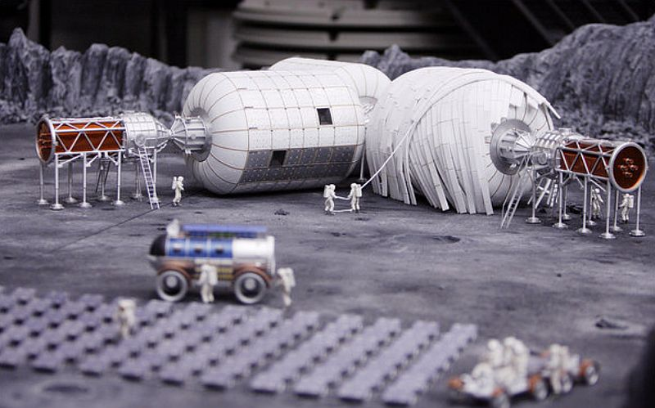
Bigelow’s Concept

Slide 11
Flat-roofed for Regolith Shielding
Notes:
11

Slide 12
Flat-roofed for Regolith Shielding
Notes:
12

Slide 13
Specialty Modules

Slide 14
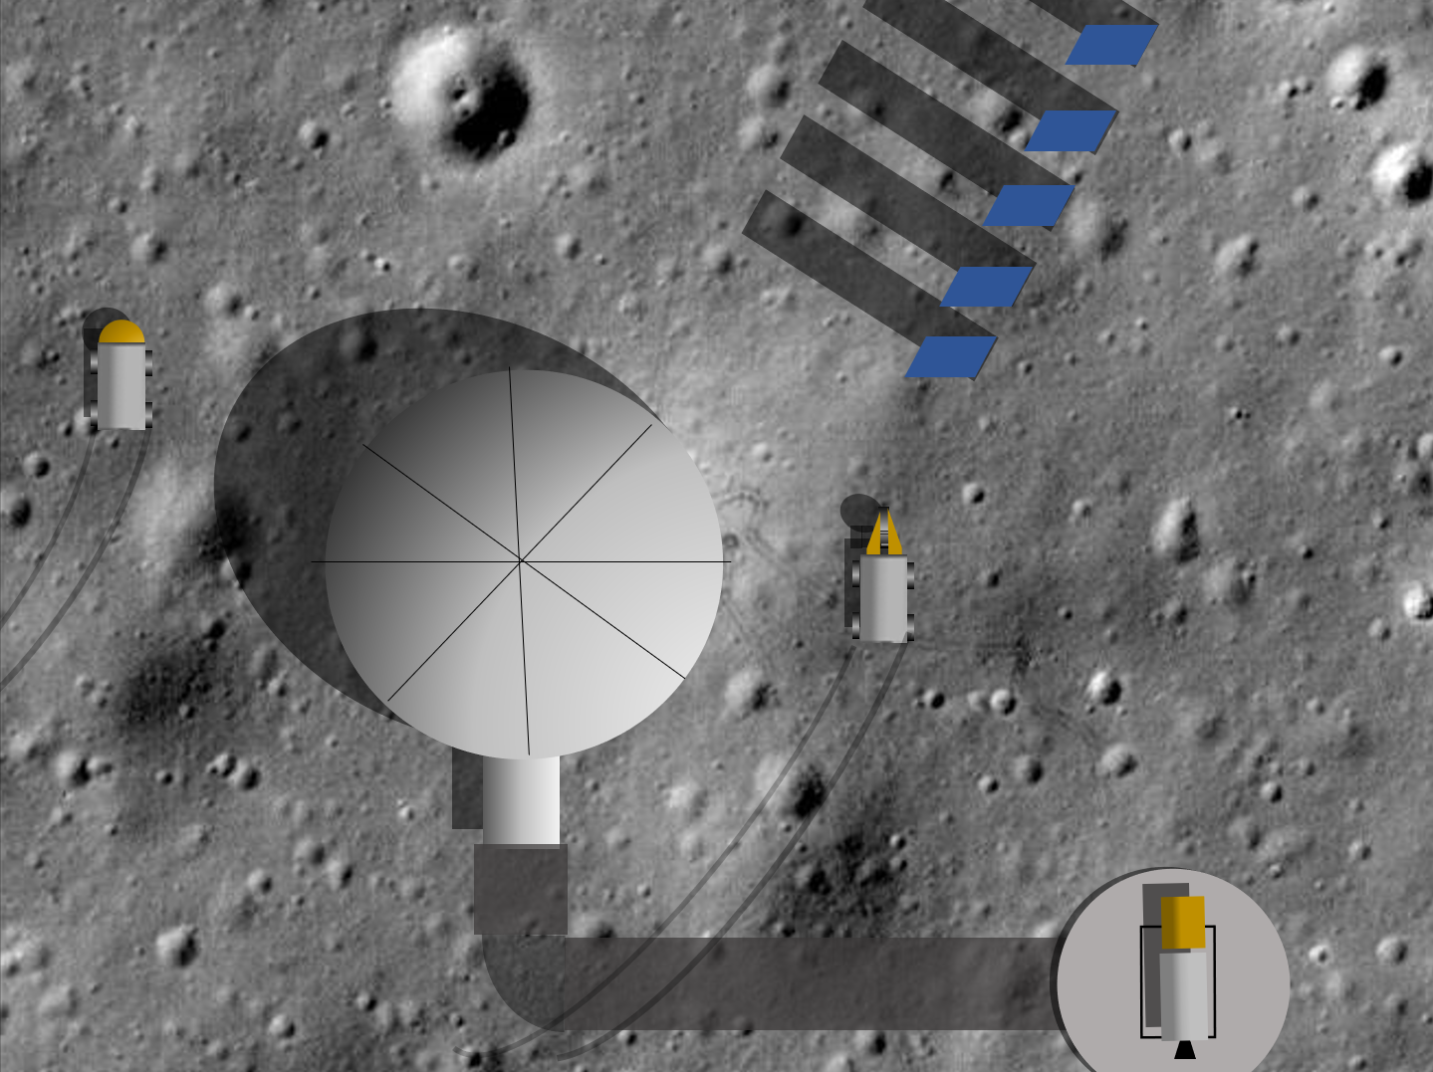
UniHab Provides All Necessities
Notes:
14

Slide 15
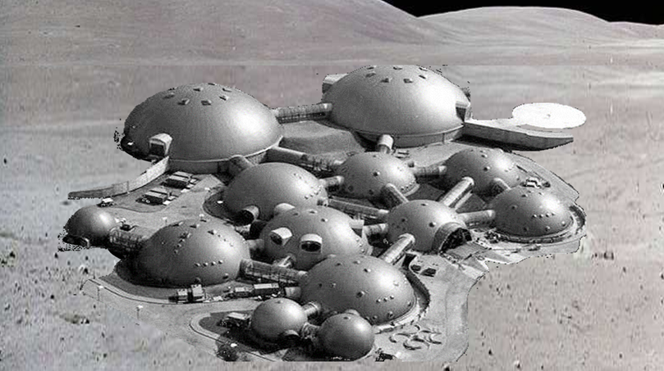
A Growing Base
Illustration of a lunar base adapted from Radio Muzyka Fakty (Poland)

Slide 16
UniHab: Detailed Look
Notes:
16

Slide 17
Hydroponic Greenhouse
Notes:
17

Slide 18
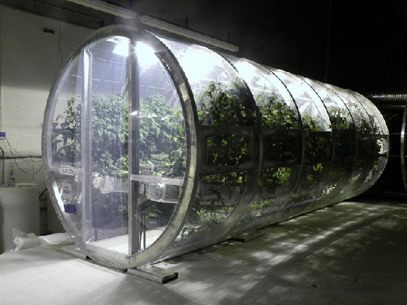
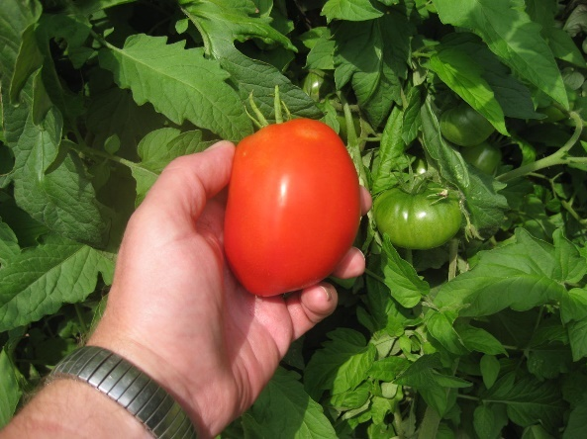
Hydroponic Greenhouse
Notes:
18

Slide 19
Aquaponics
Notes:
19

Slide 20
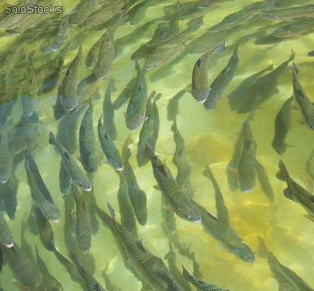
Aquaponics
Notes:
20

Slide 21
Centrifuge
Notes:
21

Slide 22
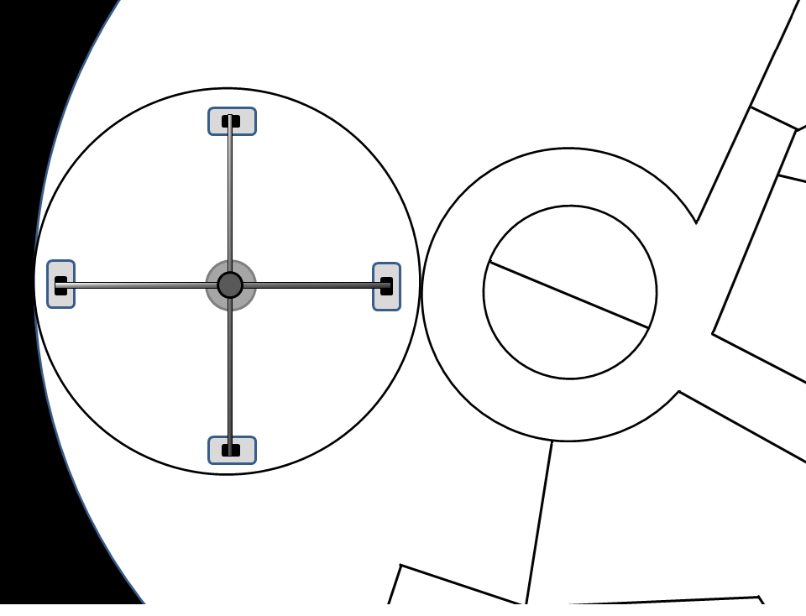
Centrifuge
Notes:
22

Slide 23
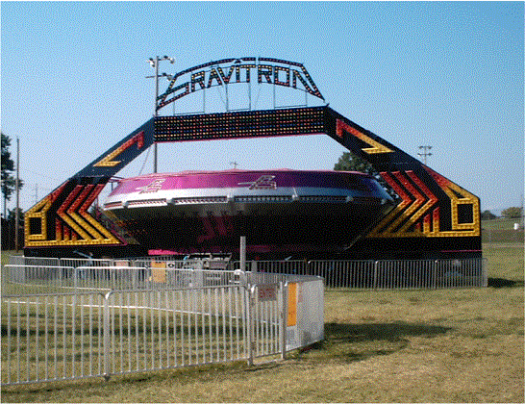
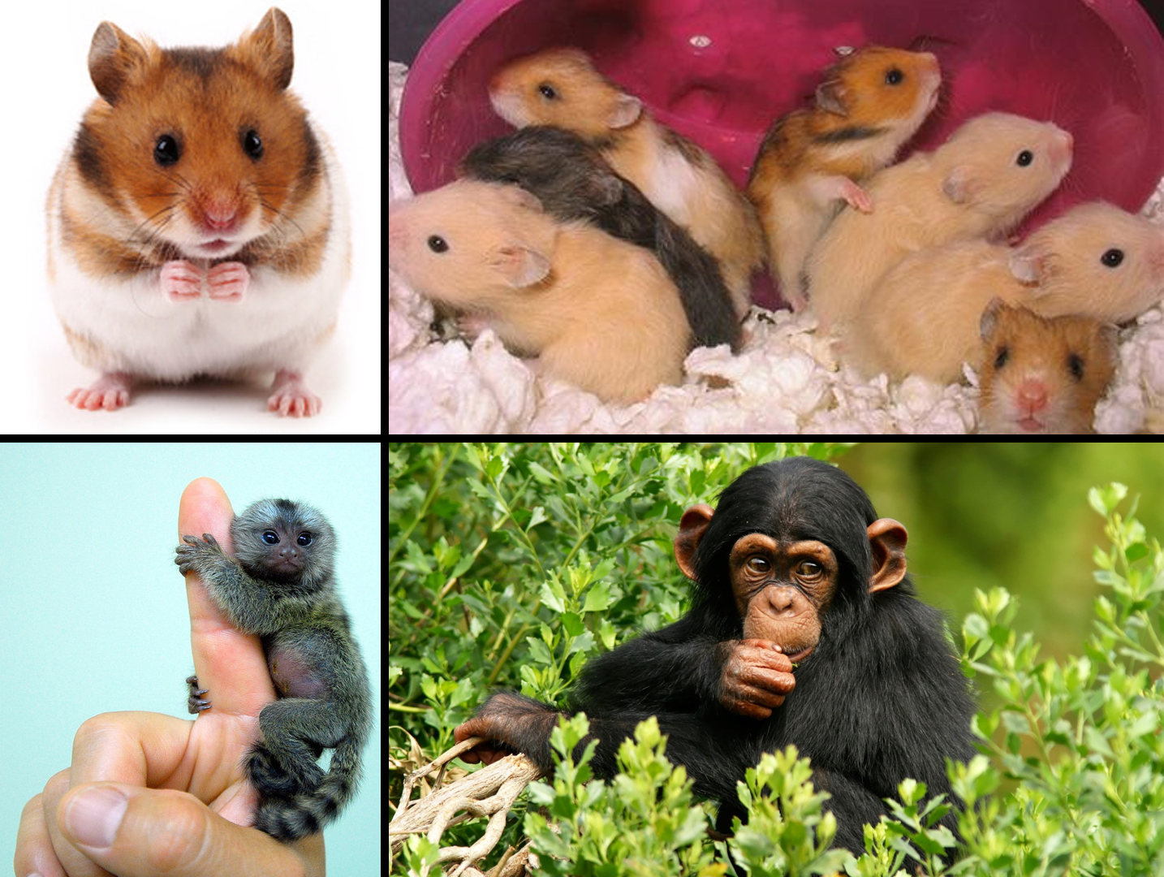
Centrifuge: Crew Health & AG Rx
Notes:
23

Slide 24
Work & Living Areas
Notes:
24

Slide 25
Bedrooms
Notes:
25

Slide 26
Extending Crew Stay
Notes:
26

Slide 27
From UniHab to Growing Base / Colony
Notes:
27

Slide 28
6

Slide 29
7

Slide 30
Performance Center
Greenhouse
Living & Working Areas
Observatory
Centrifuge
Storage

Slide 31
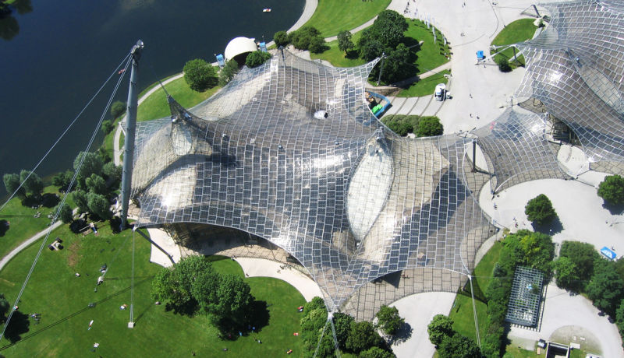
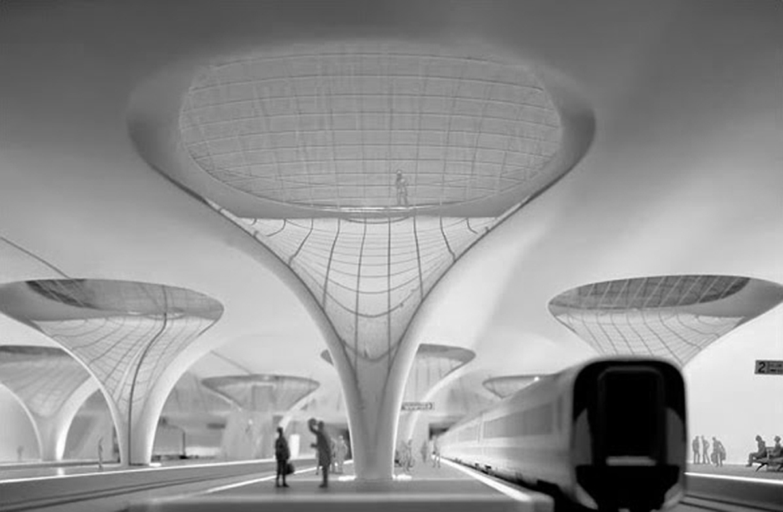
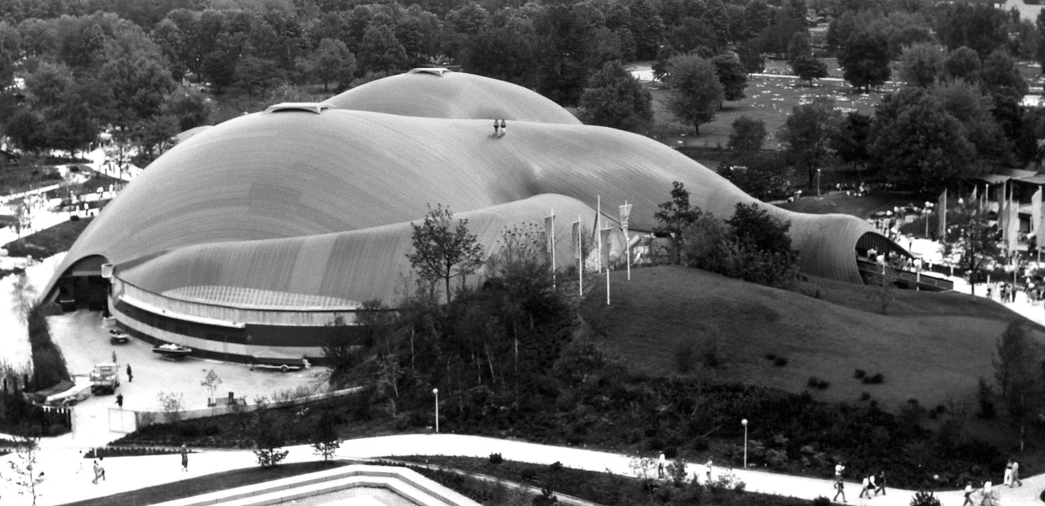
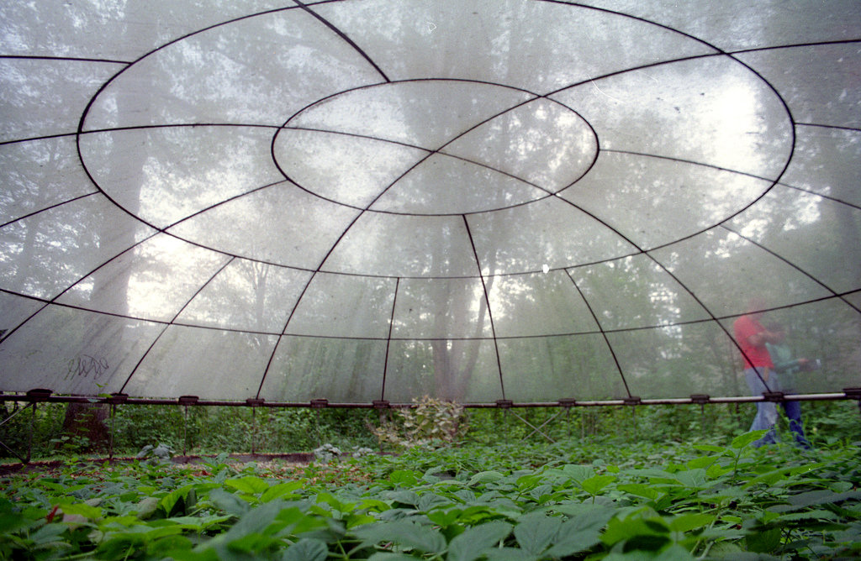
Frei Otto
Frei Otto
26

Slide 32
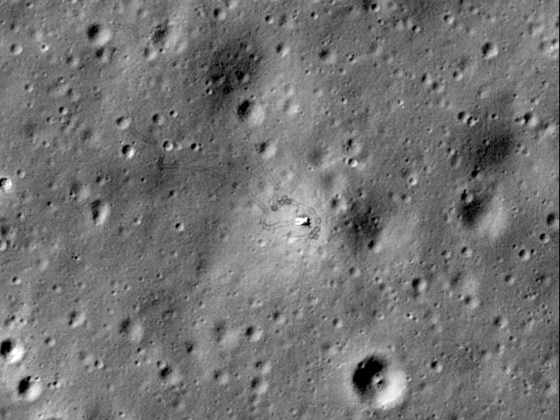

Slide 33
UniHab

Slide 34
ILRF
UniHab

Slide 35
Large Centrifuge
Farm
ILRF
Barn
UniHab
Shop

Slide 36
Hotel Luna
Large Centrifuge
Farm
ILRF
Barn
UniHab
Shop

Slide 37
Hotel Luna
Large Centrifuge
Retirement Community
Farm
ILRF
Barn
UniHab
Shop

Slide 38
Hotel Luna
Large Centrifuge
Indoor Golf Course
Retirement Community
Farm
ILRF
Barn
UniHab
Shop
More Retirement Community
Fitness Center
Store
Swimming Pool

Slide 39
Hotel Luna
Large Centrifuge
Indoor Golf Course
Retirement Community
Farm
ILRF
Barn
UniHab
Regular Community
Shop
More Retirement Community
Fitness Center
Store
Swimming Pool
School

Slide 40
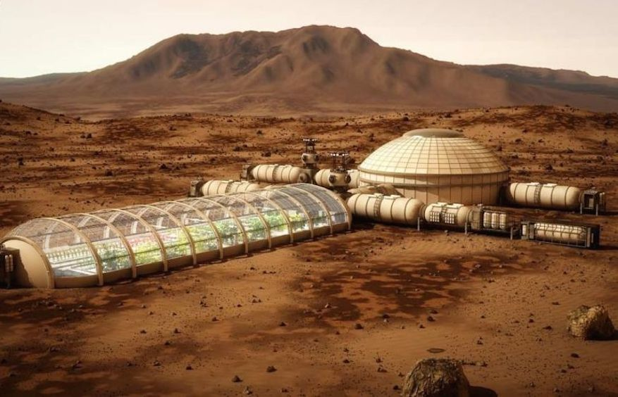
Duplicate on Mars
Image: Bryan Versteeg
Notes:
40

Slide 41
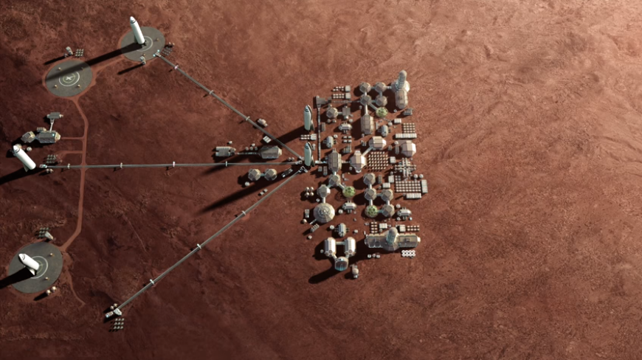
Duplicate on Mars
Notes:
41

Slide 42
UniHab at the MMAB
Notes:
42

Slide 43
Kickstarter Campaign
Notes:
43

Slide 44
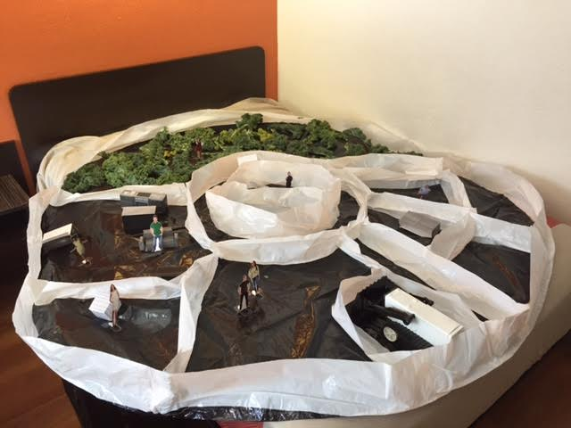
Scale Model Demo

Slide 45
Thank you for your attention

