Slide 1
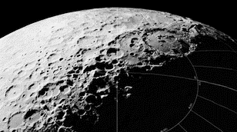
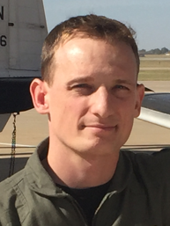
Children, Family,
& Population Growth
Alexander Layendecker, MPH, PhD, ACS
Researcher, Human Sexuality
Space Development Network
a.layendecker@asri.space

Slide 2
Overview
Initial crew composed of couples
Challenges to reproduction
Preventing infertility vs Preventing pregnancy
AG Rx for gestation & childhood
The first child born off Earth
The social environment for children

Slide 3
Reasons for Earth Independence?
Reduce costs.
Increase security.
Ensure the survival of the human species.
Ensure the survival of the biosphere.
Notes:
3

Slide 4
Sending “Coupled” Crews
Advantages:
Crew Cohesion
Unified Families
Multi-generational Capable
Improved Crew Dynamics
Improved Duty Performance
Disadvantages:
Potential affairs
Tribalism
Jealousy/Resentments
Preferential Treatment

Slide 5
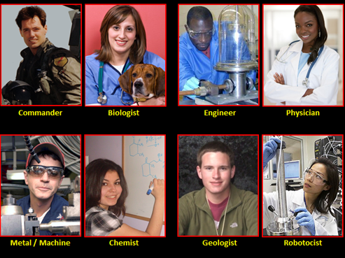
Sending “Coupled” Crews

Slide 6
Challenges to Reproduction
Radiation
Mitigation: Living below the surface
Will not have benefit of magnetosphere and atmosphere
Microgravity
Mitigation: Artificial Gravity; Simulated Earth environment
Evolution in a 1 Earth G environment
Mars – 0.38 G, Moon – 0.16 G
Synergistic effects: Fertilization, Gestation, Development, Delivery, Birth and Postnatal care
Copulation appears wholly doable

Slide 7
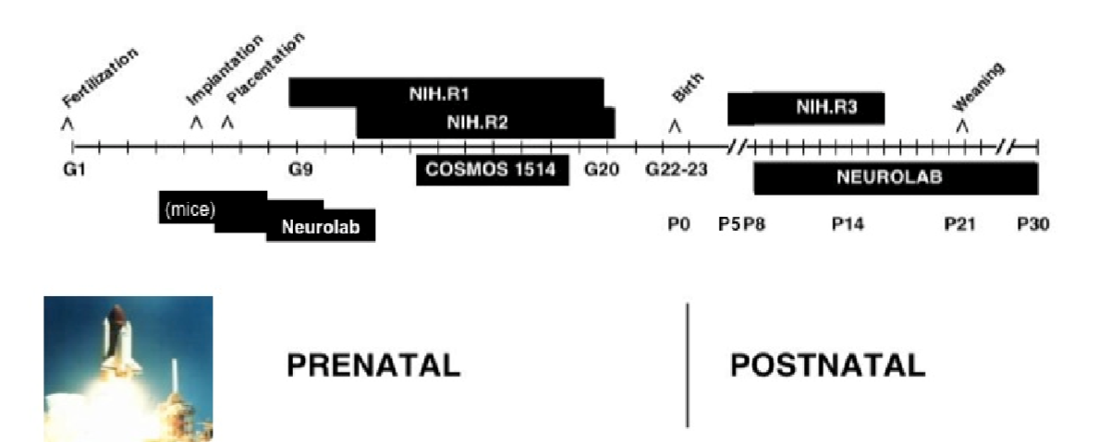

Slide 8
Preventing Infertility vs Preventing Births
Preventing Infertility
Preventing Births
Radiation damage to gametes and reproductive systems (males vs females)
Ectopic Pregnancies, Cytoskeletal deformities during development, Hydrocephaly
Endometriosis
Contraception use by Astronauts
Implantation concerns
Abstinence
Vasectomies/Tubal ligation

Slide 9
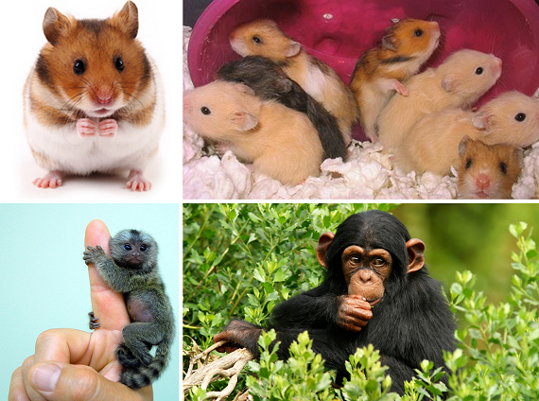
Artificial Gravity Rx
Relatively untested, particularly with pregnant mothers, infants, small children
Small mammal experiments
Centrifuge arm length
“Orbital Incubator” concept

Slide 10
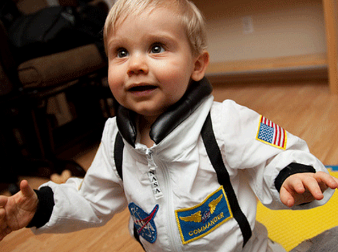
First Off-World Birth
SpaceBorn United (previously SpaceLife Origin)
based in the Netherlands, projecting first baby born in space 2024.
Ethical/medical/legal considerations.
Birth on the Moon, Mars, or in a spacecraft/station
Gravity level “window” baselines will be moved

Slide 11
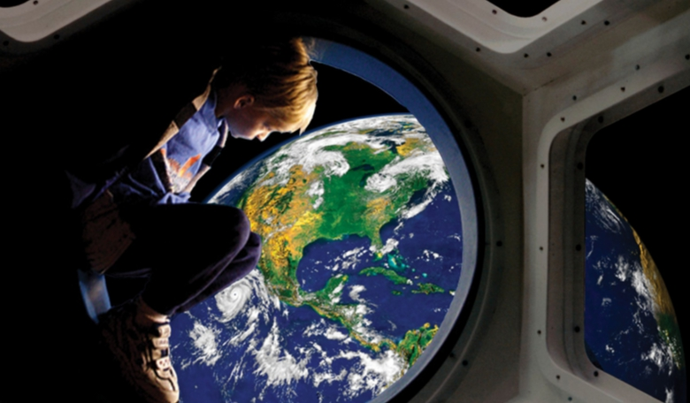
Social Environment for Children
Frontier-like isolation
Micro-society
Sparse resources
Education system
Play → Lessons Derived
Living inside a compact world
Potential returns to Earth

Slide 12
Conclusions
Enabling reproduction in space is indispensable to our
survival as a species.
Mitigation techniques exist but will likely be very expensive and could require extensive engineering.
Ability to reproduce genetic lines in space is the truest measure of Earth independence.
Family units will form the core of colonial outposts in space, as they have throughout history.
Numerous challenges/pitfalls
exist, with much research remaining to be done.

Slide 13
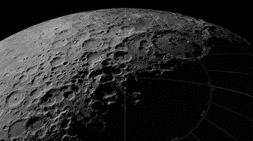
Q&A Session
Alexander Layendecker, MPH, PhD, ACS
Researcher, Human Sexuality
Space Development Network
a.layendecker@asri.space

